Slide 1

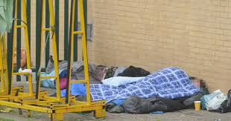

View of dementia from a public health and population perspective
Carol Brayne
Director
Cambridge Institute of Public Health
DCRC/DTA webinar, June 2019

Slide 2
Framework (Public Health)
What is the condition and its context (within us and within societies)
Is there any evidence of change
What does this mean

Slide 3
The role of population studies to provide evidence
Working on areas of importance to society
Describing disorders/states which are identified as key
What, who, when, where and why
Empirical evidence with known denominator
The meaning of the disorder/state for societies, groups and times
Relationship to other factors – risk/protection, lifecourse, natural history
Testing changes in diagnostic boundaries
Testing changes across time
Key evidence for all types of prevention

Slide 4
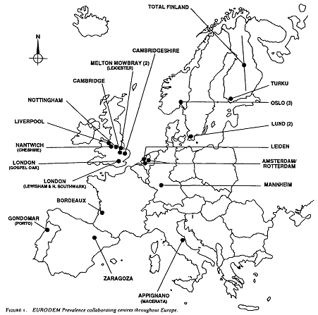
The Prevalence of Dementia in Europe: a collaborative study of 1980-l990 findings. Int J of Epidemiol 1991, 20(3), 736-48.
Creating the population evidence base
EURODEM 1990s
(Hofman, Rocca et al)
Important for bringing dementia to world awareness

Slide 5
Prevalence of dementia in Europe by study, men and women combined.
AGE CANNOT BE IGNORED
Hofman et al Int J Epi 1991

Slide 6

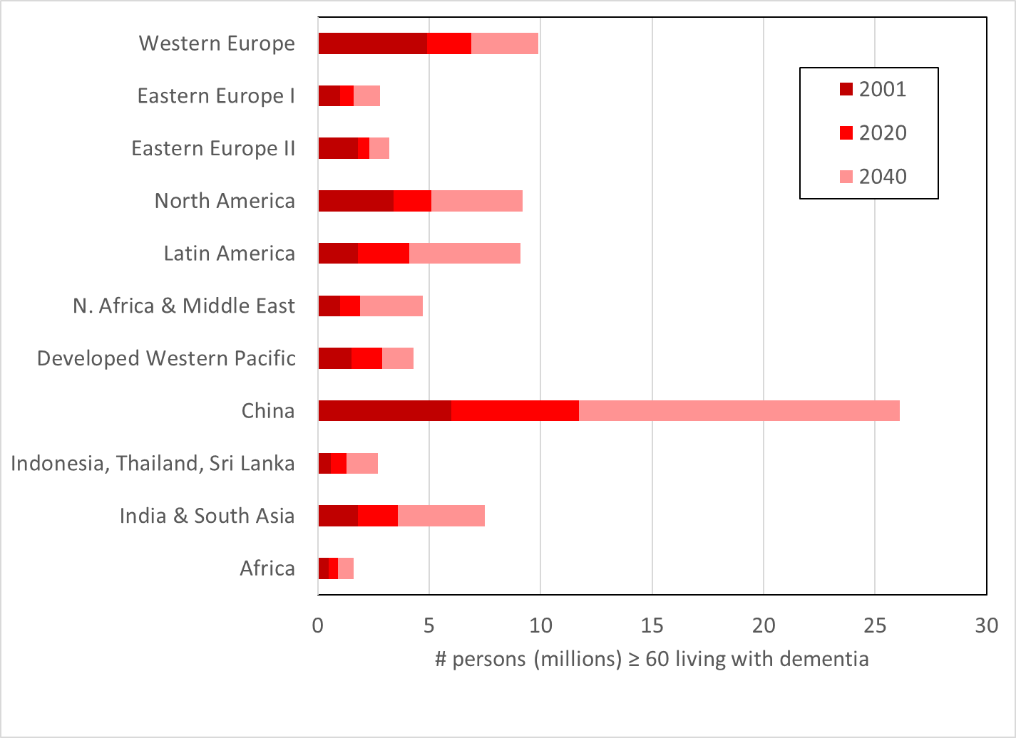
Global prevalence of dementia
Lancet 2005;366:2112-17

Slide 7
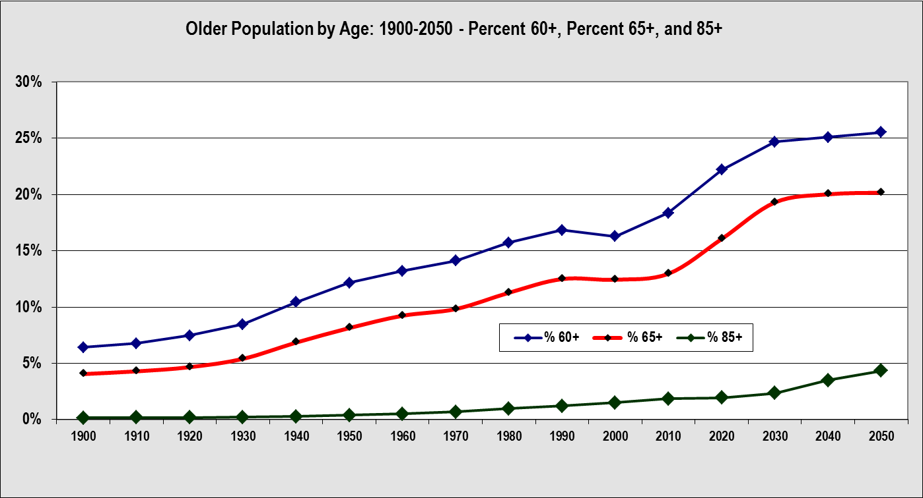
Dementia in the context of ageing populations – US as example
2010-2030
* HHS: Administration on Aging using Census data

Slide 8

Dementia syndrome itself *
Clinical dementia syndrome
Cognitive function
Functional ability
Physical health
Mental health
Consciousness
Impairment but not meeting
Clinical dementia syndrome criteria
Not meeting either of the above
None are binary
*‘225,000 will develop dementia this year, that’s one every three minutes’ taken from Alzheimer’s Society, UK June 2019

Slide 9

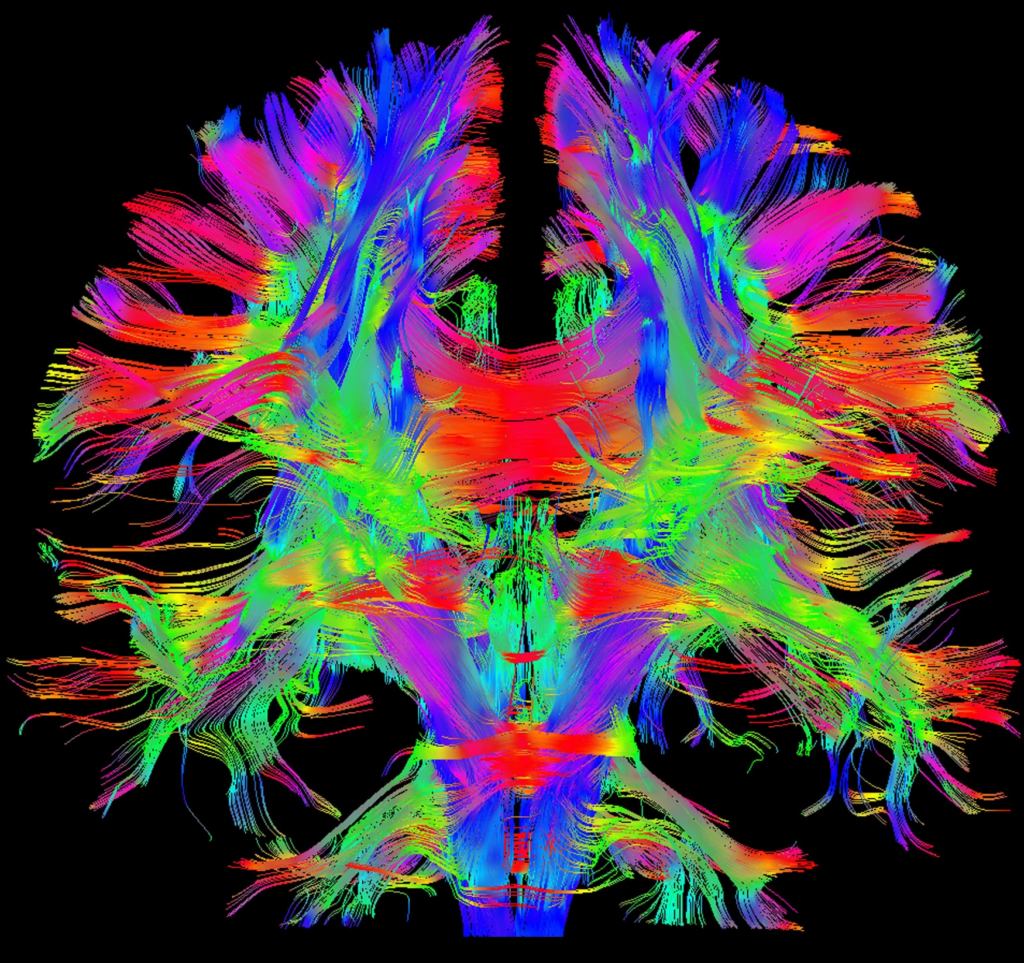
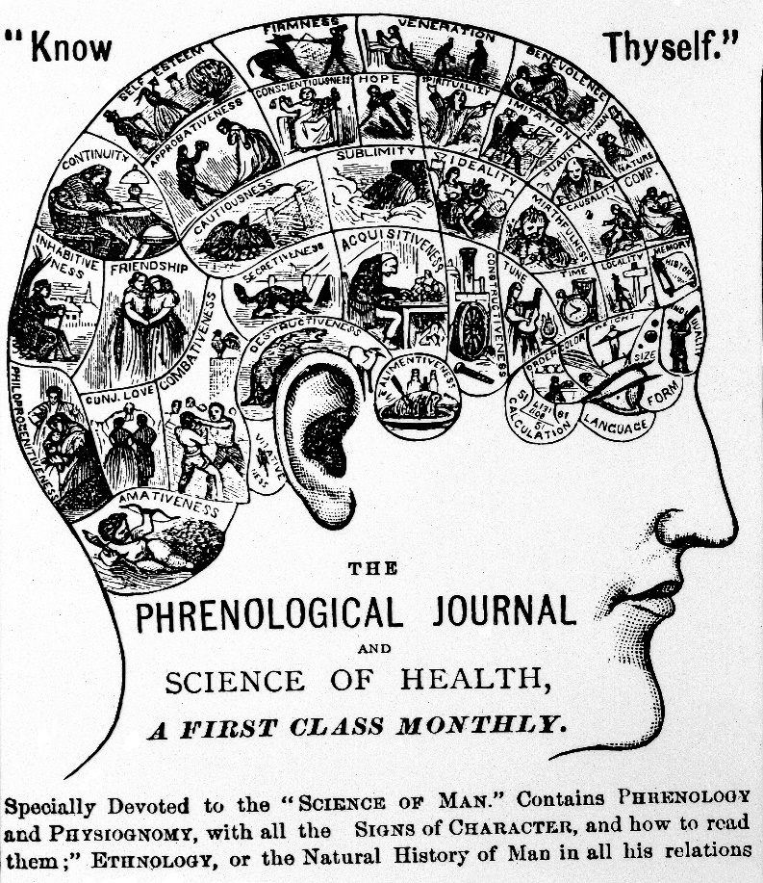
Pictures
Imaging,
-omics, data science, history and fashions

Slide 10
Alzheimer’s Disease
Neuroimaging Initiative
(mean age 75)
Why do results different from different settings appear to be conflicting?
Anticholinesterase RCTs
(mean ages 72 to 75)
Neurology
services
HTA-SADD Trial
(mean age 79)
Psychiatry
services
Young,
no major
psychiatric
disorder
Memory problem,
worried well,
relatively fit
Acutely unwell,
Chronic disorders
and/or disability
WHOLE
POPULATION
Primary
care
Secondary
care
National Dementia Audit
in General Hospitals
(mean age 83)
End stage
disease,
likely
excluded
From
dementia
trials
Frail,
may have
Cognitive
impairment,
variable proportion with
formal dementia diagnosis
Institutional
care
End of
life care
Antipsychotics in
dementia RCTs
(mean ages 70 to 80)
Example of research
output

Slide 11
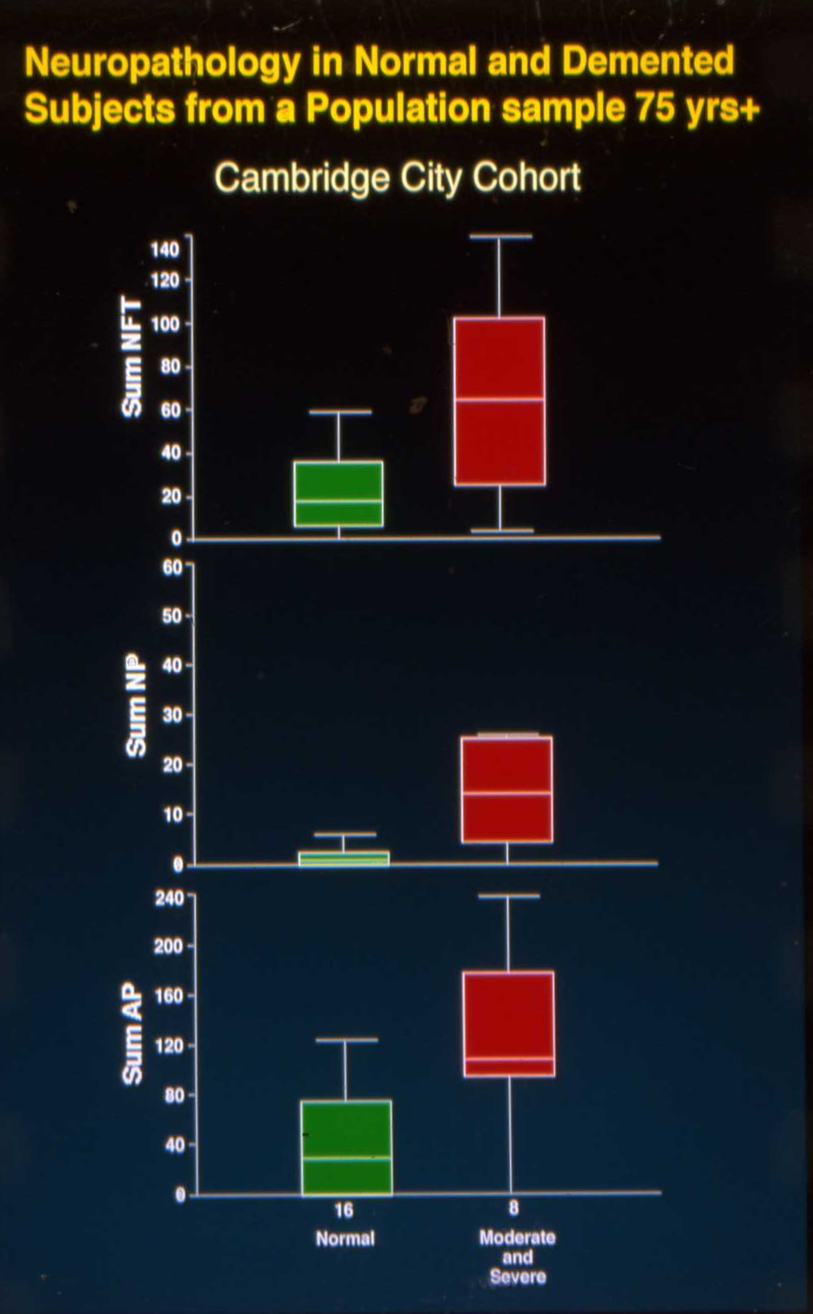
Illustration of the partial picture if we don’t study the population (communication at Lancet conference, Edinburgh, 1996)
Neurology
services
Psychiatry
services
WHOLE
POPULATION
Primary
care
Secondary
care
Institutional
care
End of
life care

Slide 12
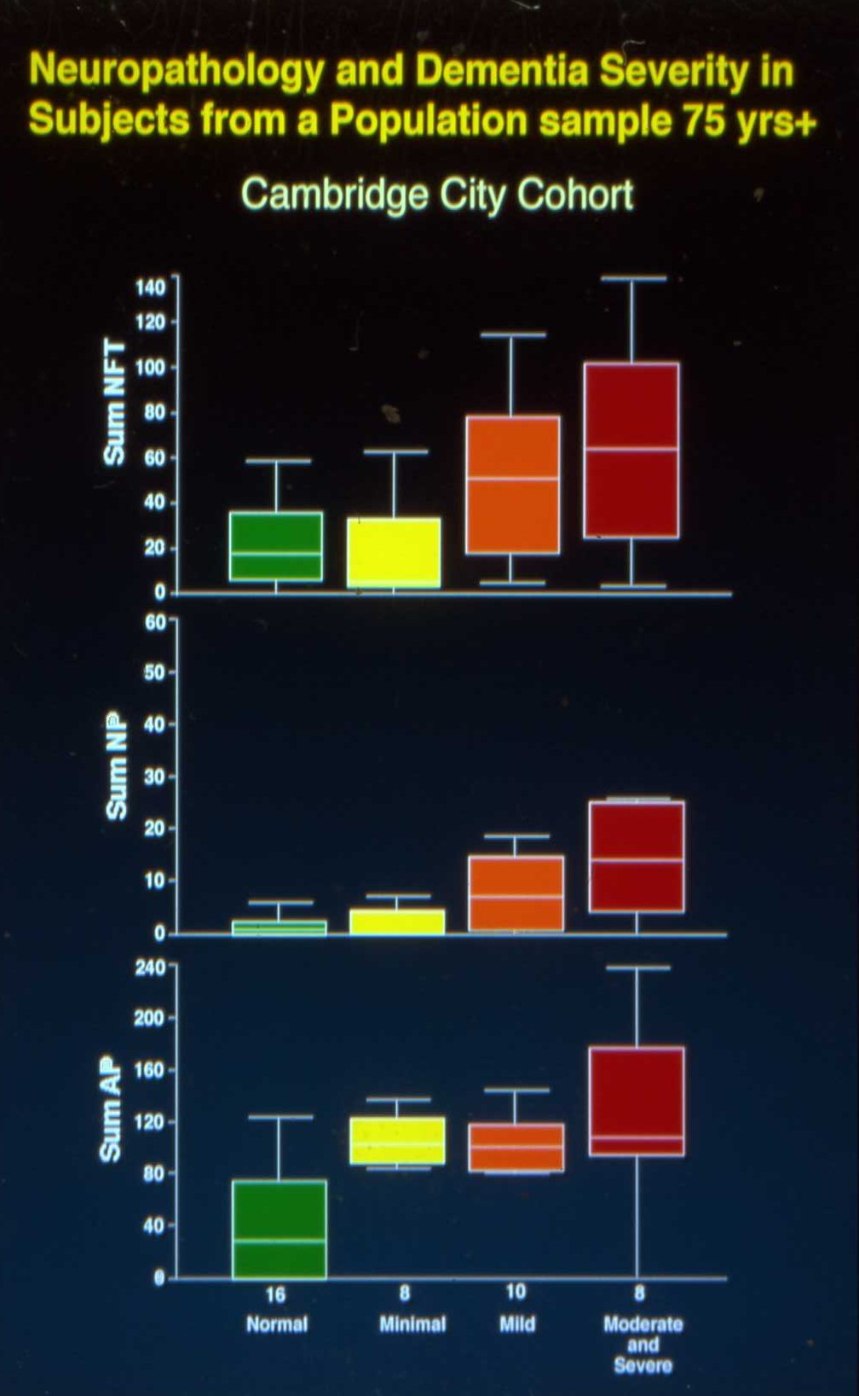
Neurology
services
Psychiatry
services
WHOLE
POPULATION
Primary
care
Secondary
care
Institutional
care
End of
life care

Slide 13
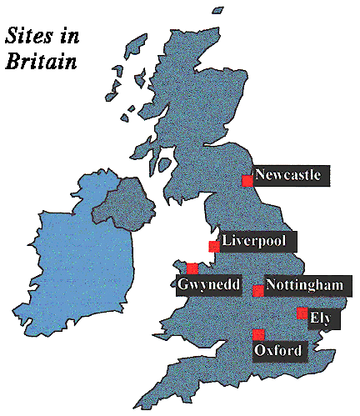
One national study:
The UK’s Cognitive Function and Ageing Studies
Notes:
Insert Map here

Slide 14
Brief design of original CFAS (MRC/DH funded)
18,304 individuals recruited 1989-93
65+ population sampling equal weight <75,75+
5 identical centres, 1 non identical centre
True populations – institutions included
~ 80% response rate at each stage
Subsets followed at varying intervals – all at 2 and 10 years
Detailed interviews to capture data relevant to differential diagnosis of mental health disorders in later life (GMS and CAMDEX) with algorithic diagnosis of dementia status (DSM-IIIR equivalent)
Bioresource & brain donation (>500 brains)

Slide 15
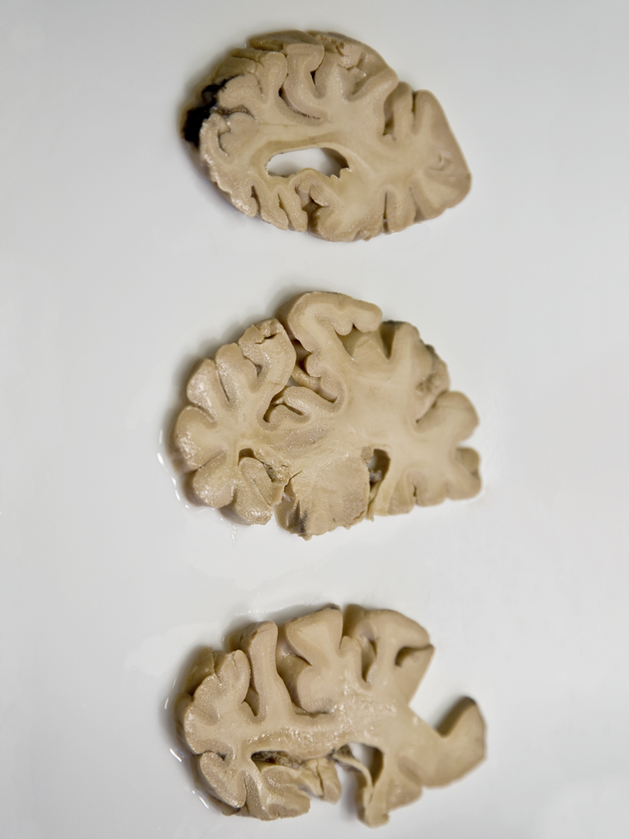
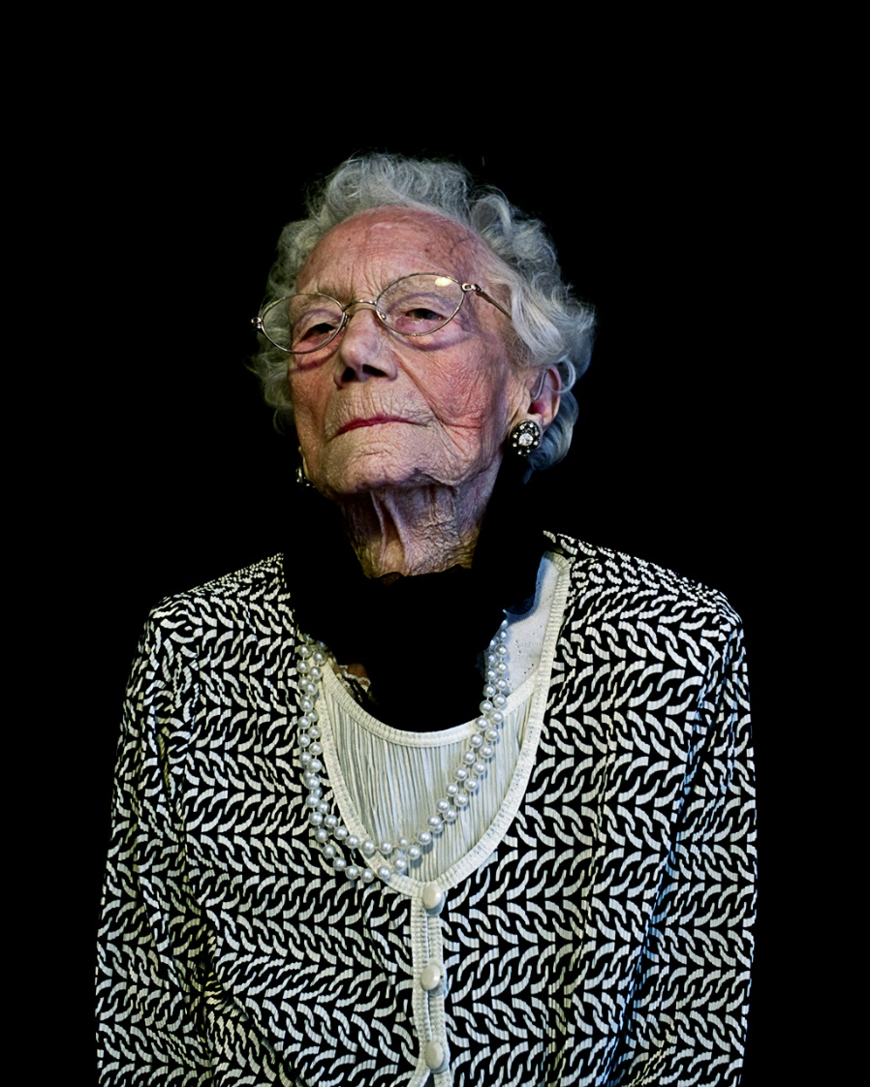



MIND OVER MATTER
BRONWYN PARRY ANIA DABROWSKA
www.mindovermatterproject.co.uk

Slide 16
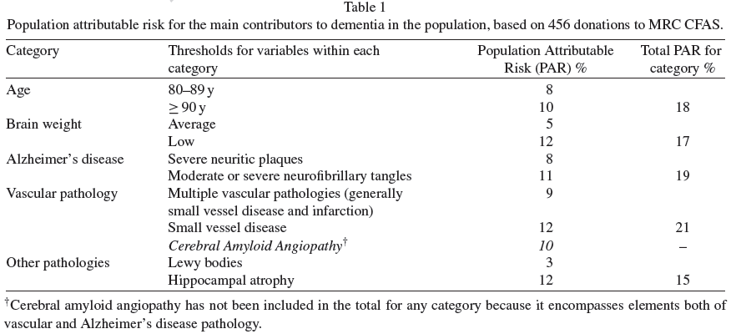
Epidemiological Neuropathology
Attributable risks for dementia at death (CFAS)
456 donations
AR – estimate of relative contributions of specific pathologies to dementia at death
Table 1 from

Slide 17
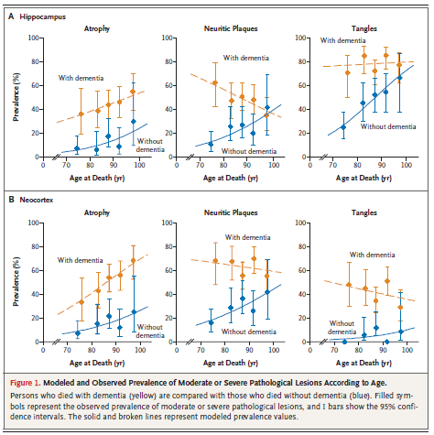
Age matters: AD neuropath loses its close association with dementia in the oldest old
NEJM 2009;
360:2302-2309

Slide 18
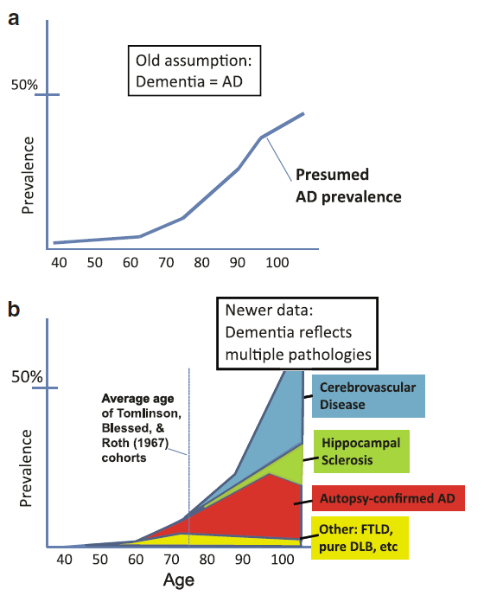

Age
Studies of subjects in advanced old age require an overhaul of prior assumptions
With thanks to Peter Nelson for H.Scl slides

Slide 19
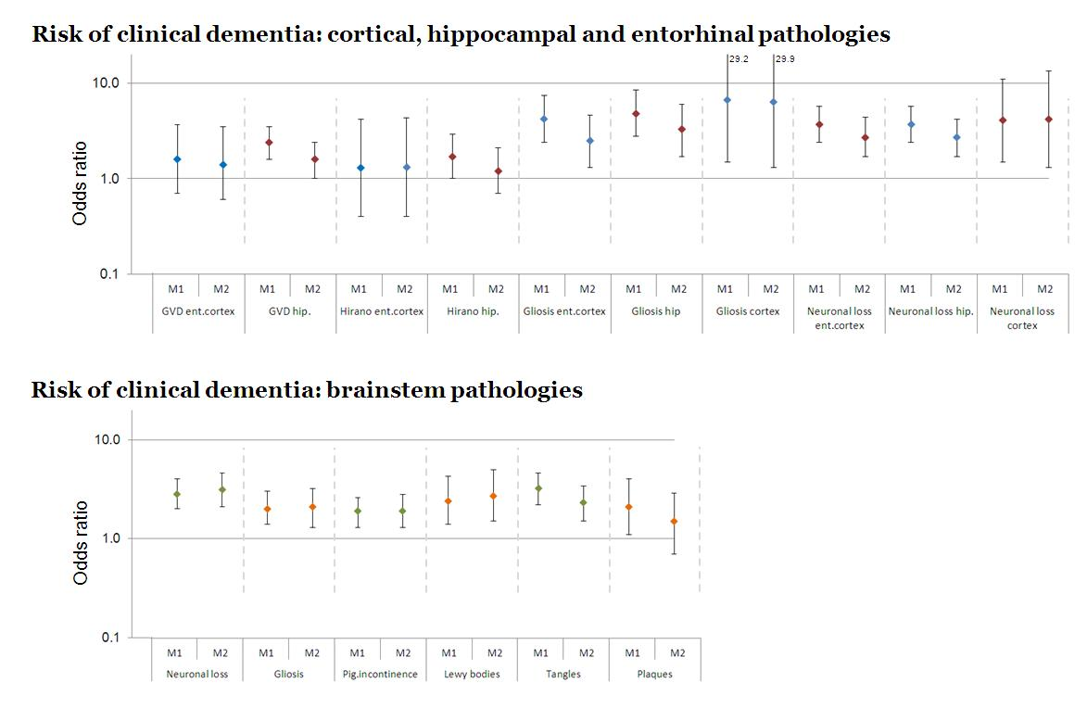
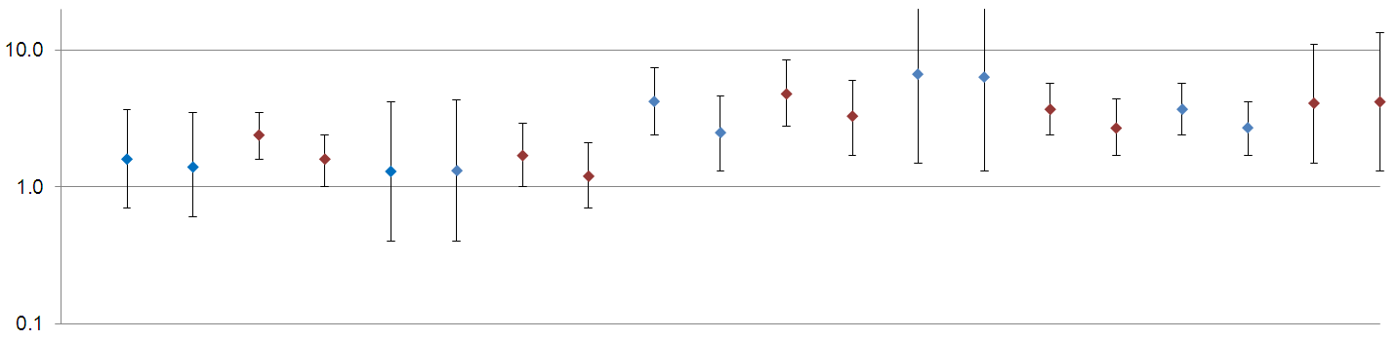
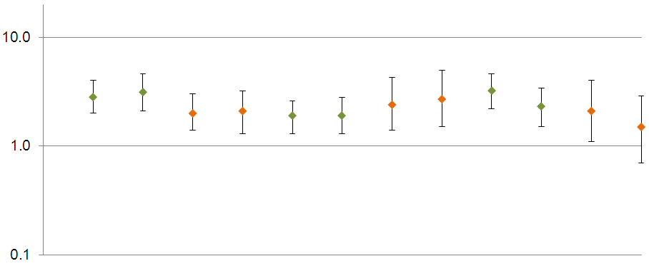
Less common and “disregarded” pathologies in late onset dementia matter
M1= adjusted for age group, study and sex
M2=adjusted for age group, study, sex, cortical neuritic plaques and Braak stage
Keage et al, JAD 2012
Risk of clinical dementia: cortical, hippocampal and entorhinal pathologies
Key
Ent.cotex – entorhinal cortex
Hip. – hippocampus
Pig.incontinence - pigmentary incontinence
GVD – granulovacuolar degeneration
Hirano – Hirano bodies
Odds ratio
Risk of clinical dementia: brainstem pathologies
Figure 2. Associations (odds ratios and 95% confidence internals) between cortical, hippocampal and entorhinal, and brainstem pathologies and clinical dementia status at death.
Model 1/M1 adjusted for age group, study and sex
Model 2/M2 adjusted for age group, study, sex, cortical neuritic plaques and Braak stage
Odds ratio
Notes:
Findings
Findings contribute to the emerging understanding that late onset dementia is associated with a broad range of neuropathologies and anatomical regions. Gliosis and neuronal loss appear to play independent roles (when taking into account classic makers), as do a variety of pathologies within the brainstem.
Findings
Findings contribute to the emerging understanding that late onset dementia is associated with a broad range of neuropathologies and anatomical regions. Gliosis and neuronal loss appear to play independent roles (when taking into account classic makers), as do a variety of pathologies within the brainstem.
Methods
The sample was drawn from the Epidemiological CLInicoPathological Studies in Europe (EClipSE) project (www.eclipsestudy.eu) which is a harmonisation of population-based autopsy and clinical data (in this case, the MRC Cognitive Function and Ageing Study and the City of Cambridge over-75 Cohort).
627 individuals aged 71-103 years, 55% clinically demented at death.

Slide 20
In advanced old age,
non-AD diseases
underlie much of
clinical dementia.
“Classic” clin-path
studies addressed
younger cohorts in
clinic-based contexts.
Age
Nelson et al,
Acta Neuropathologica
2011

Slide 21
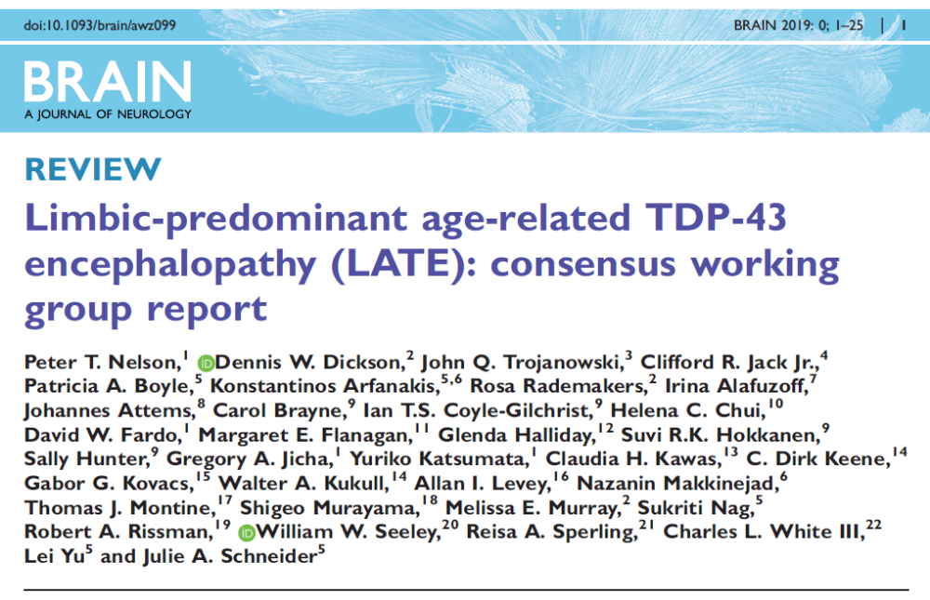

Slide 22
Beyond dementia: cognitive transitions are influenced by ‘cognitive lifestyle’ (top third v lower third)
0.58
(0.45, 0.74)
0.81
(0.65, 1.01)
1.06
(0.86, 1.32)
No
impairment
Slight
impairment
Moderate
impairment
Severe
impairment
2.93
(1.35, 6.38)
2.06
(0.77, 5.53)
0.83
(0.69, 1.00)
0.89
(0.66, 1.22)
1.17
(0.81, 1.70)
1.28
(1.12, 1.45)
Death
Combined education exposure, occupational complexity, social/intellectual engagement
Education and occupation closely related, mostly education driven
Later life effects independent (Marioni et al, 2011)

Slide 23
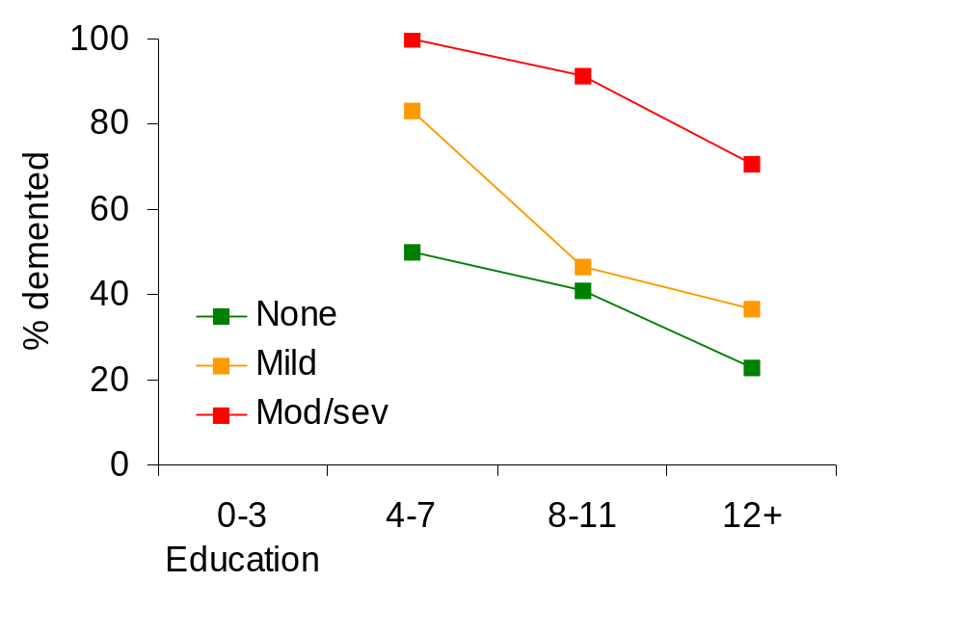
Influences beyond traditional neuropathologies matter: cognitive/brain reserve & compensation, empirical data
Biological mechanisms - Cortical plaques (none, mild, mod/sev), education levels and expression of dementia from ECliPSE,
Those with highest level of education have least dementia at death for each level of cortical plaques
Brayne et al 2011

Slide 24
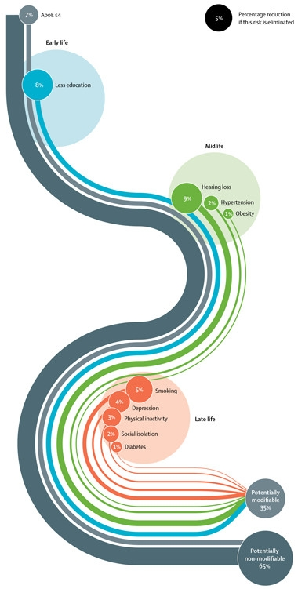
Synthesis of risk data- modelling prevention potential
Seven risk factors emerged from cohort studies
Potential proportion of dementia (AD) in the population that might be attributed to seven risk factors (with assumptions)
30% attributable to
  diabetes,
  midlife hypertension,
  midlife obesity,
  physical inactivity,
  depression,
  smoking,
  low educational attainment
  taking into account the important inter-relationships between these variables
(Norton et al, Lancet Neurol 2014, method adopted by Lancet Commission with addition of 2 further risk factors, 2017)
Notes:
Seven risk factors for dementia
Modelling work undertaken by researchers within the NIHR Collaborative Leadership in Applied Research and Care East of England (CLAHRC EoE) updated the potential proportion of dementia in the population that might be prevented through tackling seven risk factors. This exercise led to an estimate of 30% of cases being associated with one or more of these risks (Lancet Neurology 2014).

Slide 25
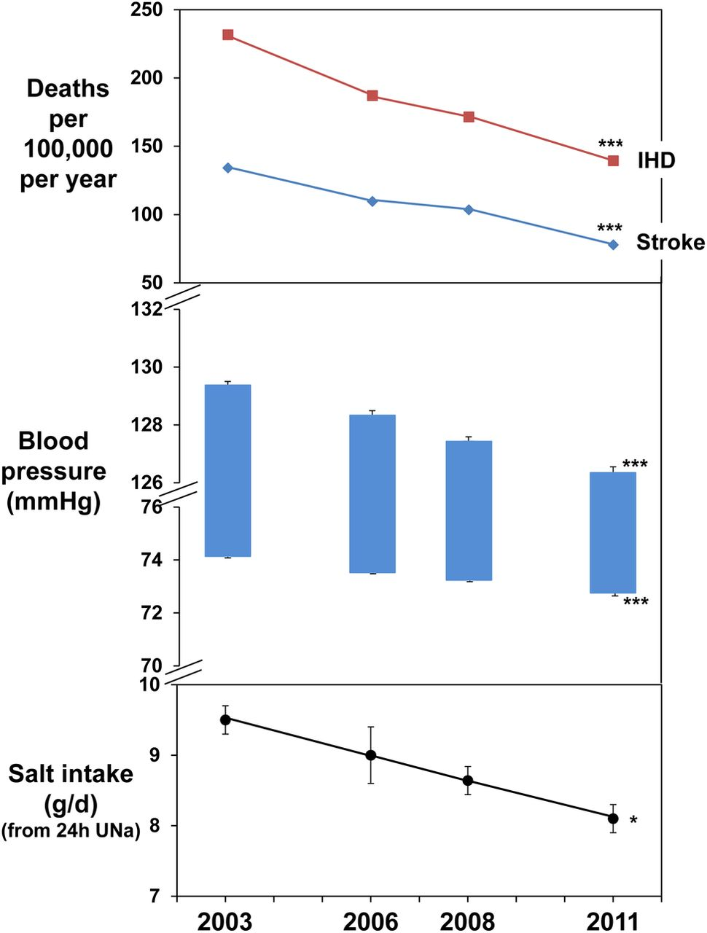
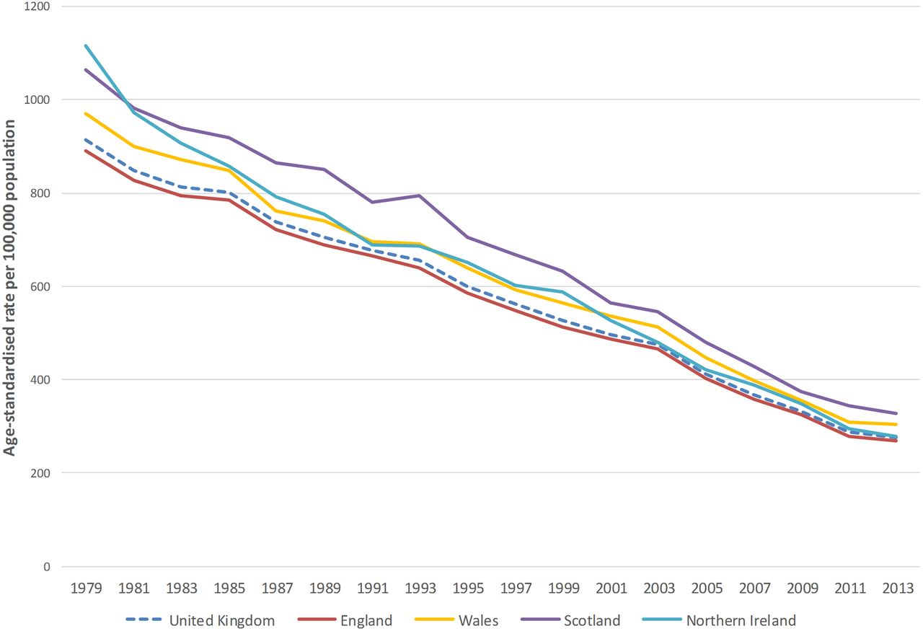


Dramatic changes in cardiovascular disease and risk factors in populations
Age-standardised death rates per 100 000 from cardiovascular disease, all ages, UK and England, Wales, Scotland, Northern Ireland, 1979–2013.
Feng J He et al. BMJ Open 2014;4:e004549
Prachi Bhatnagar et al. Heart 2016;102:1945-1952
©2014 by British Medical Journal Publishing Group
Notes:
Changes in salt intake as measured by 24 h urinary sodium excretion (UNa), blood pressure, stroke and ischaemic heart disease (IHD) mortality in England from 2003 to 2011. *p<0.05, ***p<0.001 for trend.

Slide 26
Evidence of change: CFAS II
Notes:
Insert Map here

Slide 27
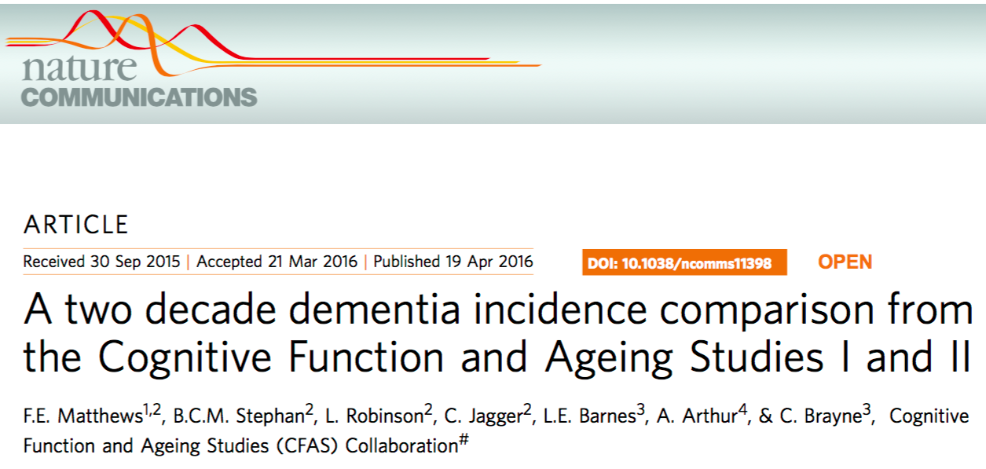
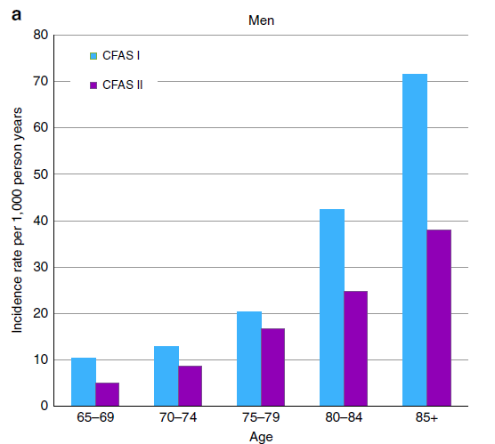
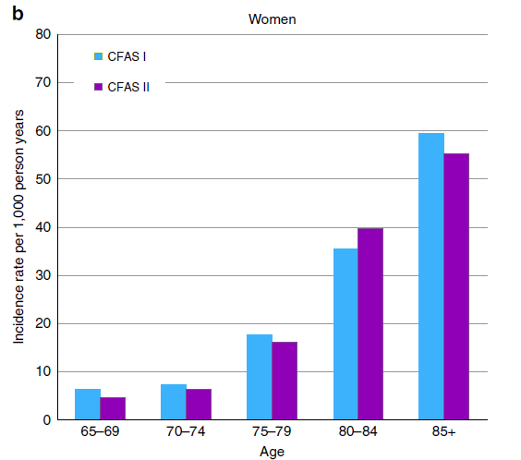
CFAS I (1989 – 1994)
  n = 5,156
CFAS II (2008 – 2011)
  n = 5,288
Summary:
Decrease in incidence of dementia, driven mostly by decrease in incidence among Males

Slide 28
Alzheimer Cohorts Consortium
9 prospective, population cohorts
  Population-based
  Prospectively collected
  A sample size of at least 3,000 at baseline
  Similar methods of assessment of dementia
Incidence Rates (IR) over period of 5 years
  All data from 1988 through 2015
  Stratified by age group & sex
Trends in Incidence
  Over 25 years (1990 – 2015)
  All-cause dementia
  Alzheimer’s Disease
  Stratified by sex
Age, Gene/Environment Susceptibility (AGES)-Reykjavik Study
Atherosclerosis Risk in Communities (ARIC) study
Cardiovascular Health Study (CHS)
Cognitive Function and Ageing Studies (CFAS)
Framingham Heart Study (FHS)
Gothenburg population studies
Personnes Agées QUID (PAQUID) study
Rotterdam Study
Three-City Study (3C)

Slide 29
Characteristics of Cohorts in the Alzheimer Cohorts Consortium
Study | PAQUID | Rotterdam Study | Framingham Heart Study | Gothenburg Studies | CFAS I | CFAS II | Three-City Study | AGES, Reykjavik
Country | France | Netherlands | USA | Sweden | UK | UK | France | Iceland
Sample Size | 2 960 | 10 235 | 2 596 | 1 168 | 6 441 | 11 788 | 8 250 | 5 764
Mean age, y | 27 | 25 | 25 | 23 | 2 | 2 | 13.5 | 6
Women, % | 75·3 | 71·4 | 72·1 | 76·1 | 76·4 | 76·0 | 74.0 | 77·0
Person-Years | 19 314 | 74 517 | 29 906 | 6 368 | 12 850 | 25 319 | 64 561 | 23 970
Incident dementia | 578 | 766 | 685 | 145 | 261 | 390 | 951 | 477
Incident AD | 455 | 521 | 540 | NA | NA | NA | 653 | 150
Total:
59,230 individuals
343,248 person-years

Slide 30
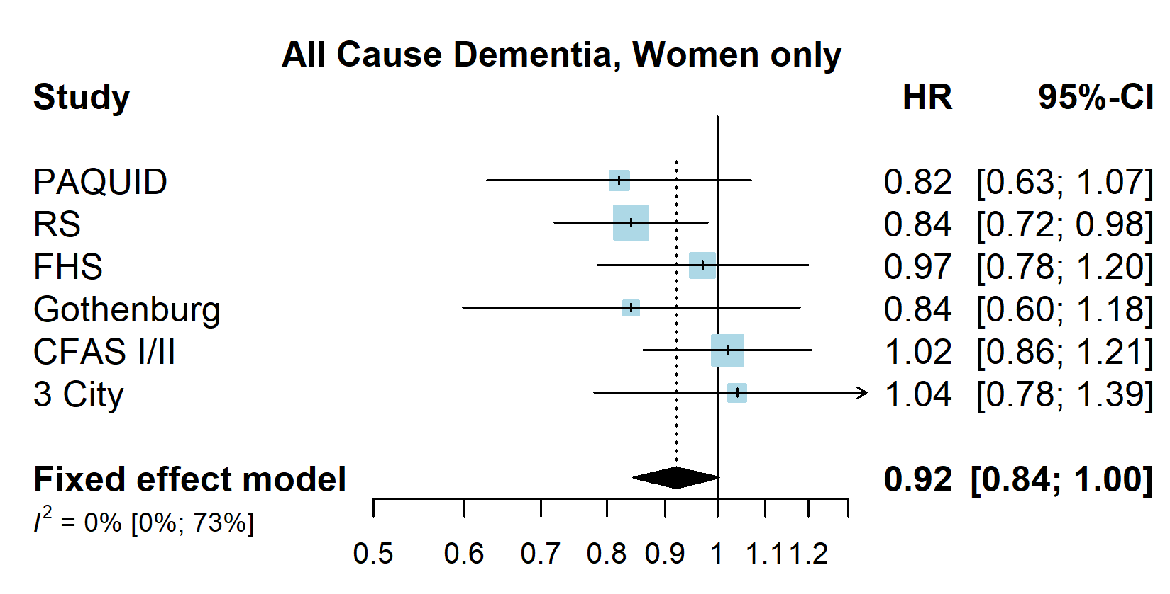
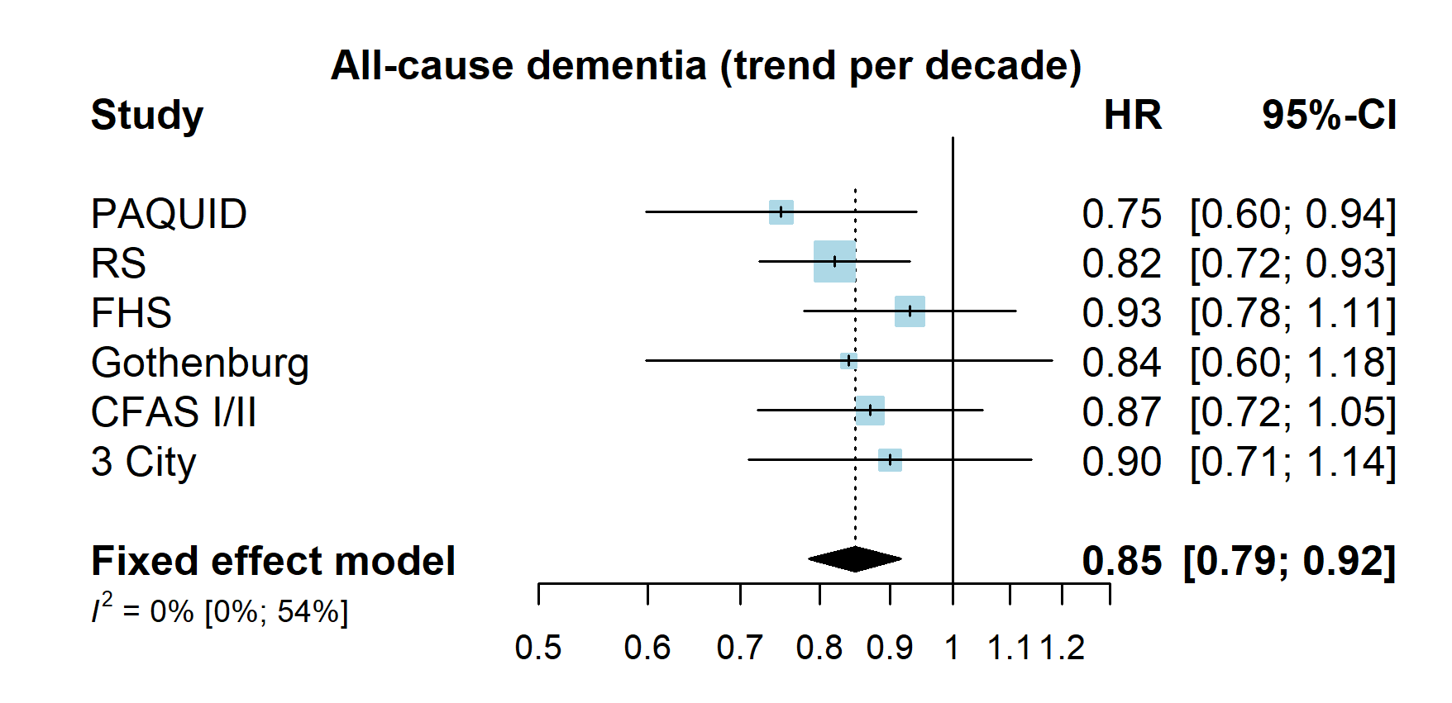
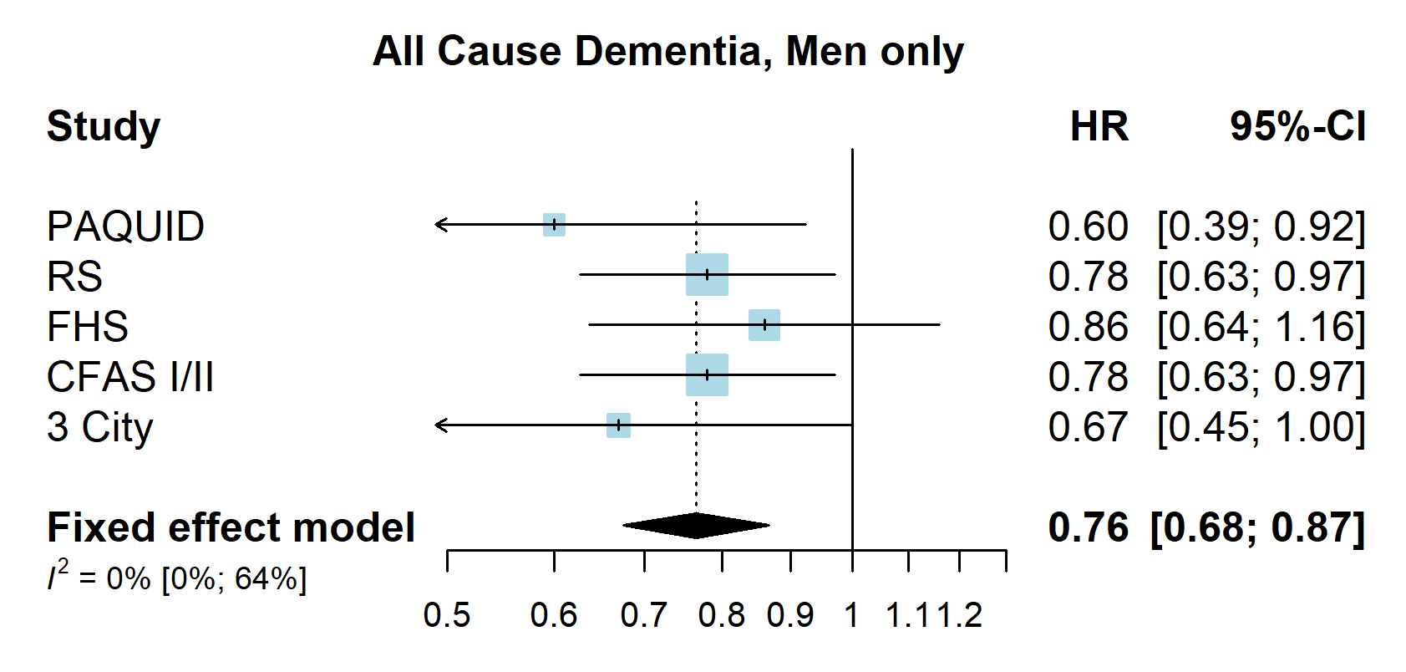
Per decade trend - All-cause dementia

Slide 31
Dementia now: multi-morbidity in different living situations (CFAS II)
Long term care settings |  | CFAS I |  |  | CFAS II
 |  | n | % | 95% CI | n | % | 95% CI
Number of health conditions¹ | 0 | 63 | 18.5 | 14.7 – 23.0 | 11 | 5.5 | 2.9 – 10.1
(not including dementia) | 1 | 53 | 15.9 | 12.3 – 20.2 | 25 | 13.2 | 8.7 – 19.6
 | 2 | 60 | 18.1 | 14.3 – 22.6 | 33 | 18.5 | 12.9 – 25.9
 | ≥3 | 158 | 47.6 | 42.3 – 53.1 | 119 | 62.7 | 54.8 – 70.0
Proportion with multi-morbidity (≥3 health conditions) increased (from 44-52% to 56-72%) between CFAS I and CFAS II
Proportion with no additional reported health conditions dropped in all settings
Key implications for design of services
Assisted living facilities |  | CFAS I |  |  | CFAS II
 |  | n | % | 95% CI | n | % | 95% CI
Number of health conditions | 0 | 52 | 7.5 | 5.7 – 9.7 | 13 | 2.9 | 1.7 – 5.1
(not including dementia) | 1 | 126 | 18.5 | 15.7 – 21.6 | 50 | 10.1 | 7.7 – 13.1
 | 2 | 149 | 22.0 | 19.0 – 25.3 | 72 | 15.1 | 12.1 – 18.7
 | ≥3 | 356 | 52.1 | 48.3 – 55.8 | 335 | 71.9 | 67.6 – 75.8
Living in the community |  | CFAS I |  |  | CFAS II
 |  | n | % | 95% CI | n | % | 95% CI
Number of health conditions | 0 | 724 | 10.9 | 10.2 – 11.7 | 492 | 6.8 | 6.3 – 7.5
(not including dementia) | 1 | 1481 | 22.4 | 21.4 – 23.4 | 1107 | 15.5 | 14.6 – 16.3
 | 2 | 1507 | 22.9 | 21.9 – 23.9 | 1512 | 21.3 | 20.4 – 22.3
 | ≥3 | 2885 | 43.9 | 42.7 – 45.1 | 3904 | 56.4 | 55.2 – 57.5
Matthews FE, Bennett H, Wittenberg R, Jagger C, Dening T, Brayne C. 2016. PLOS ONE

Slide 32
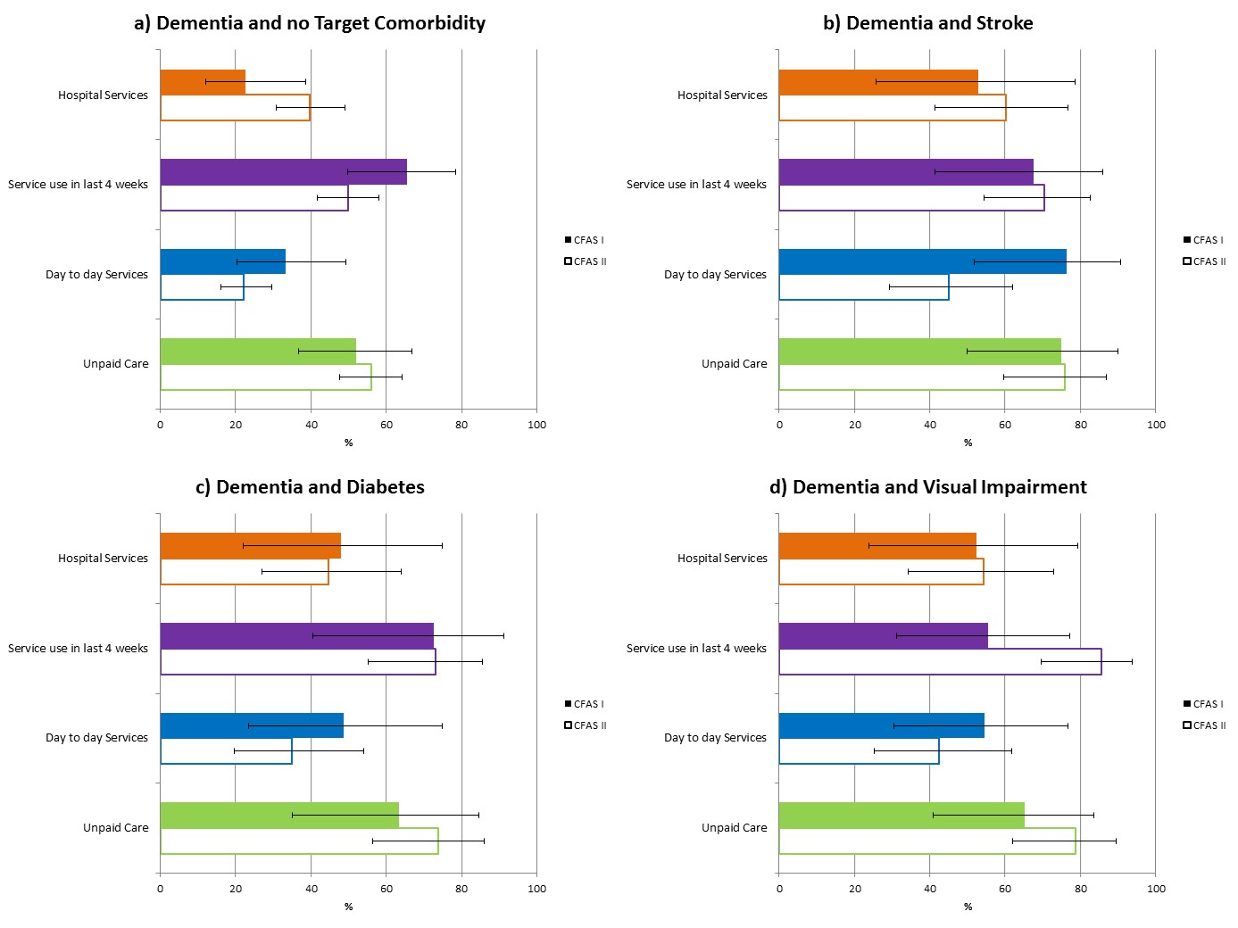
Patterns of change in services in CFAS I and CFAS II
Any comorbidity is associated with increased contact with services
For all people day to day services were less likely to be reported in CFAS II
Bennett et al. (2018) BMC Medicine

Slide 33
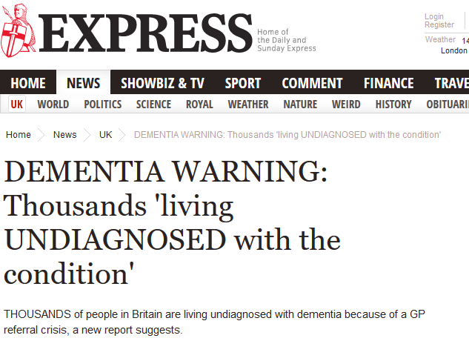
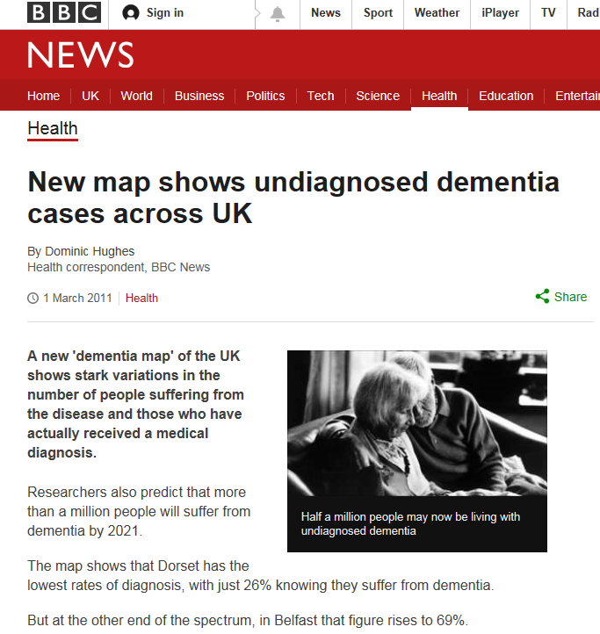
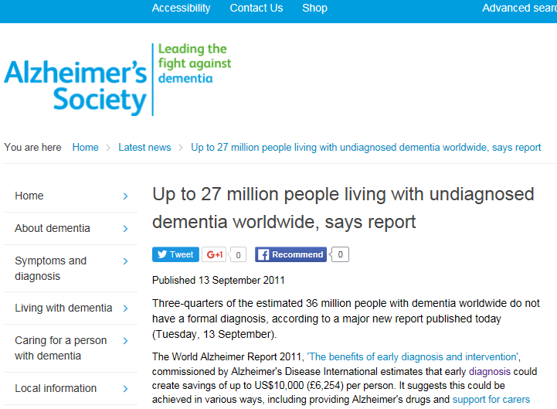
The push for ‘early’ diagnosis – what does it mean in context?

Slide 34

CFAS II Dementia Diagnosis Study
(CADDY, Savva et al, UEA)
CFAS interview data
(N=450 with dementia, 150 controls)
Dementia diagnosis
  Fact of dementia
  Domains and severity of cognitive impairment
  Non-cognitive symptoms
  Demographic factors
  Age, sex, socio-economic status, living arrangement social contact
Comorbidity
  Cardiovascular, Other chronic disease, psychiatric
Health care utilisation
Hospital stays, home service use
Primary care record
GP data available for 94% of sample
Dementia diagnosis
  Date of diagnosis, read codes used, pathway to diagnosis
Cognitive complaints
  Date of first complaint
  Who raised by
  Which tests carried out in primary care
Referrals to specialists
  Date of first referral
  Which service, patient attended, date of outcome and findings

Slide 35
What % of respondents in CFAS II with a study diagnosis of dementia had a related diagnosis/concern in their medical records 2010, 2012)

Slide 36
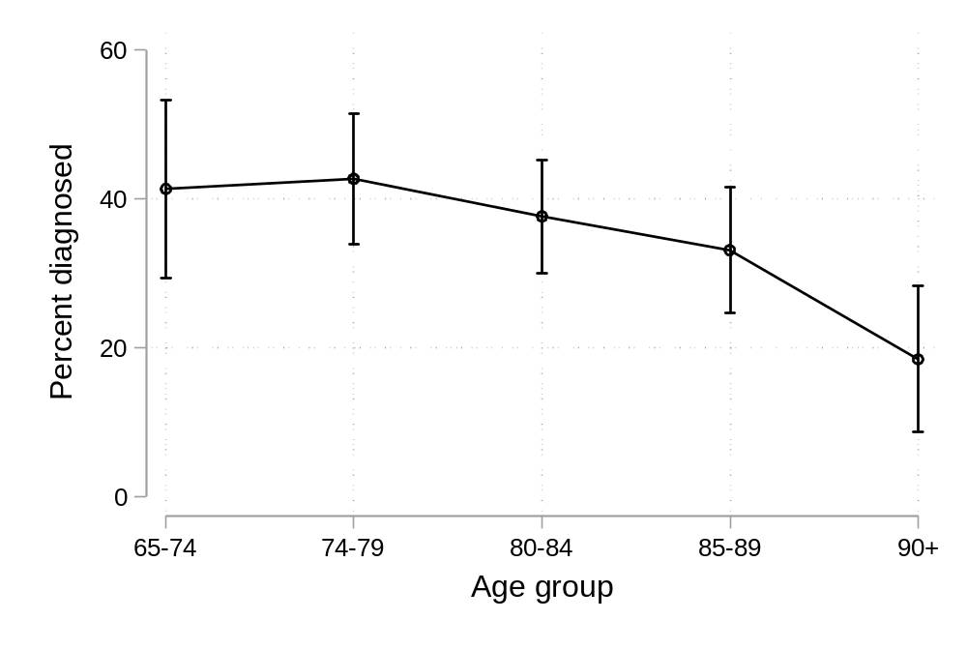
Age related to formal diagnosis
Between 2009 and 2013
Around 20% of people with CFAS study diagnosis of dementia had a cognitive concern known to GPs but without formal diagnosis.
Around 40% remained completely undetected
Six years from dementia incidence (up to 2017)
Around 60% had been diagnosed
20% alive with ‘undetected’ dementia
20% had died without a diagnosis
No clear pattern for education and social class

Slide 37
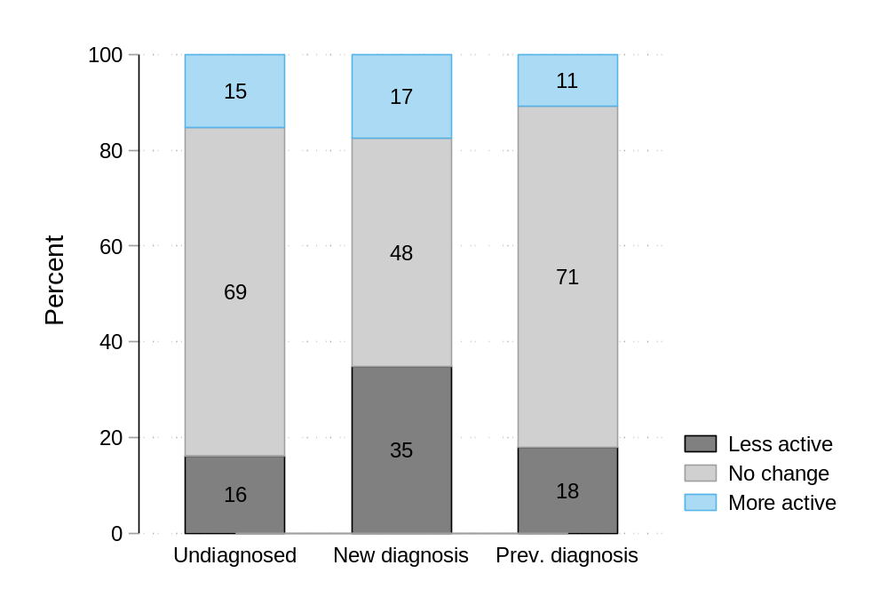
What changed after diagnosis?
Change in social activity in which person with dementia participates:
Odds of reducing participation in social activity:
3.1 (1.4-6.9)
After adjusting for dementia severity etc:
3.1 (1.3-7.6)

Slide 38
From observation to action
Finger to International Finger
MAPT
Pro Diva
Different populations, different intervention modalities, different delivery

Slide 39
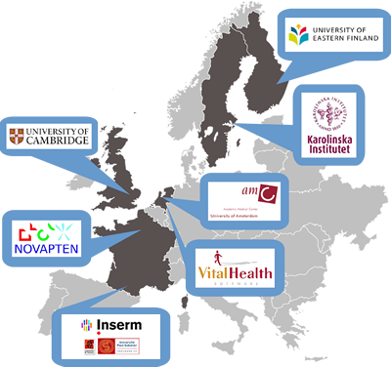



Healthy Ageing Through Internet Counselling in the Elderly
Aim
  Improve vascular risk factor management
to prevent cardiovascular disease, cognitive decline and dementia using an interactive internet intervention
www.hatice.eu
Notes:
Using an interactive internet intervention

Slide 40
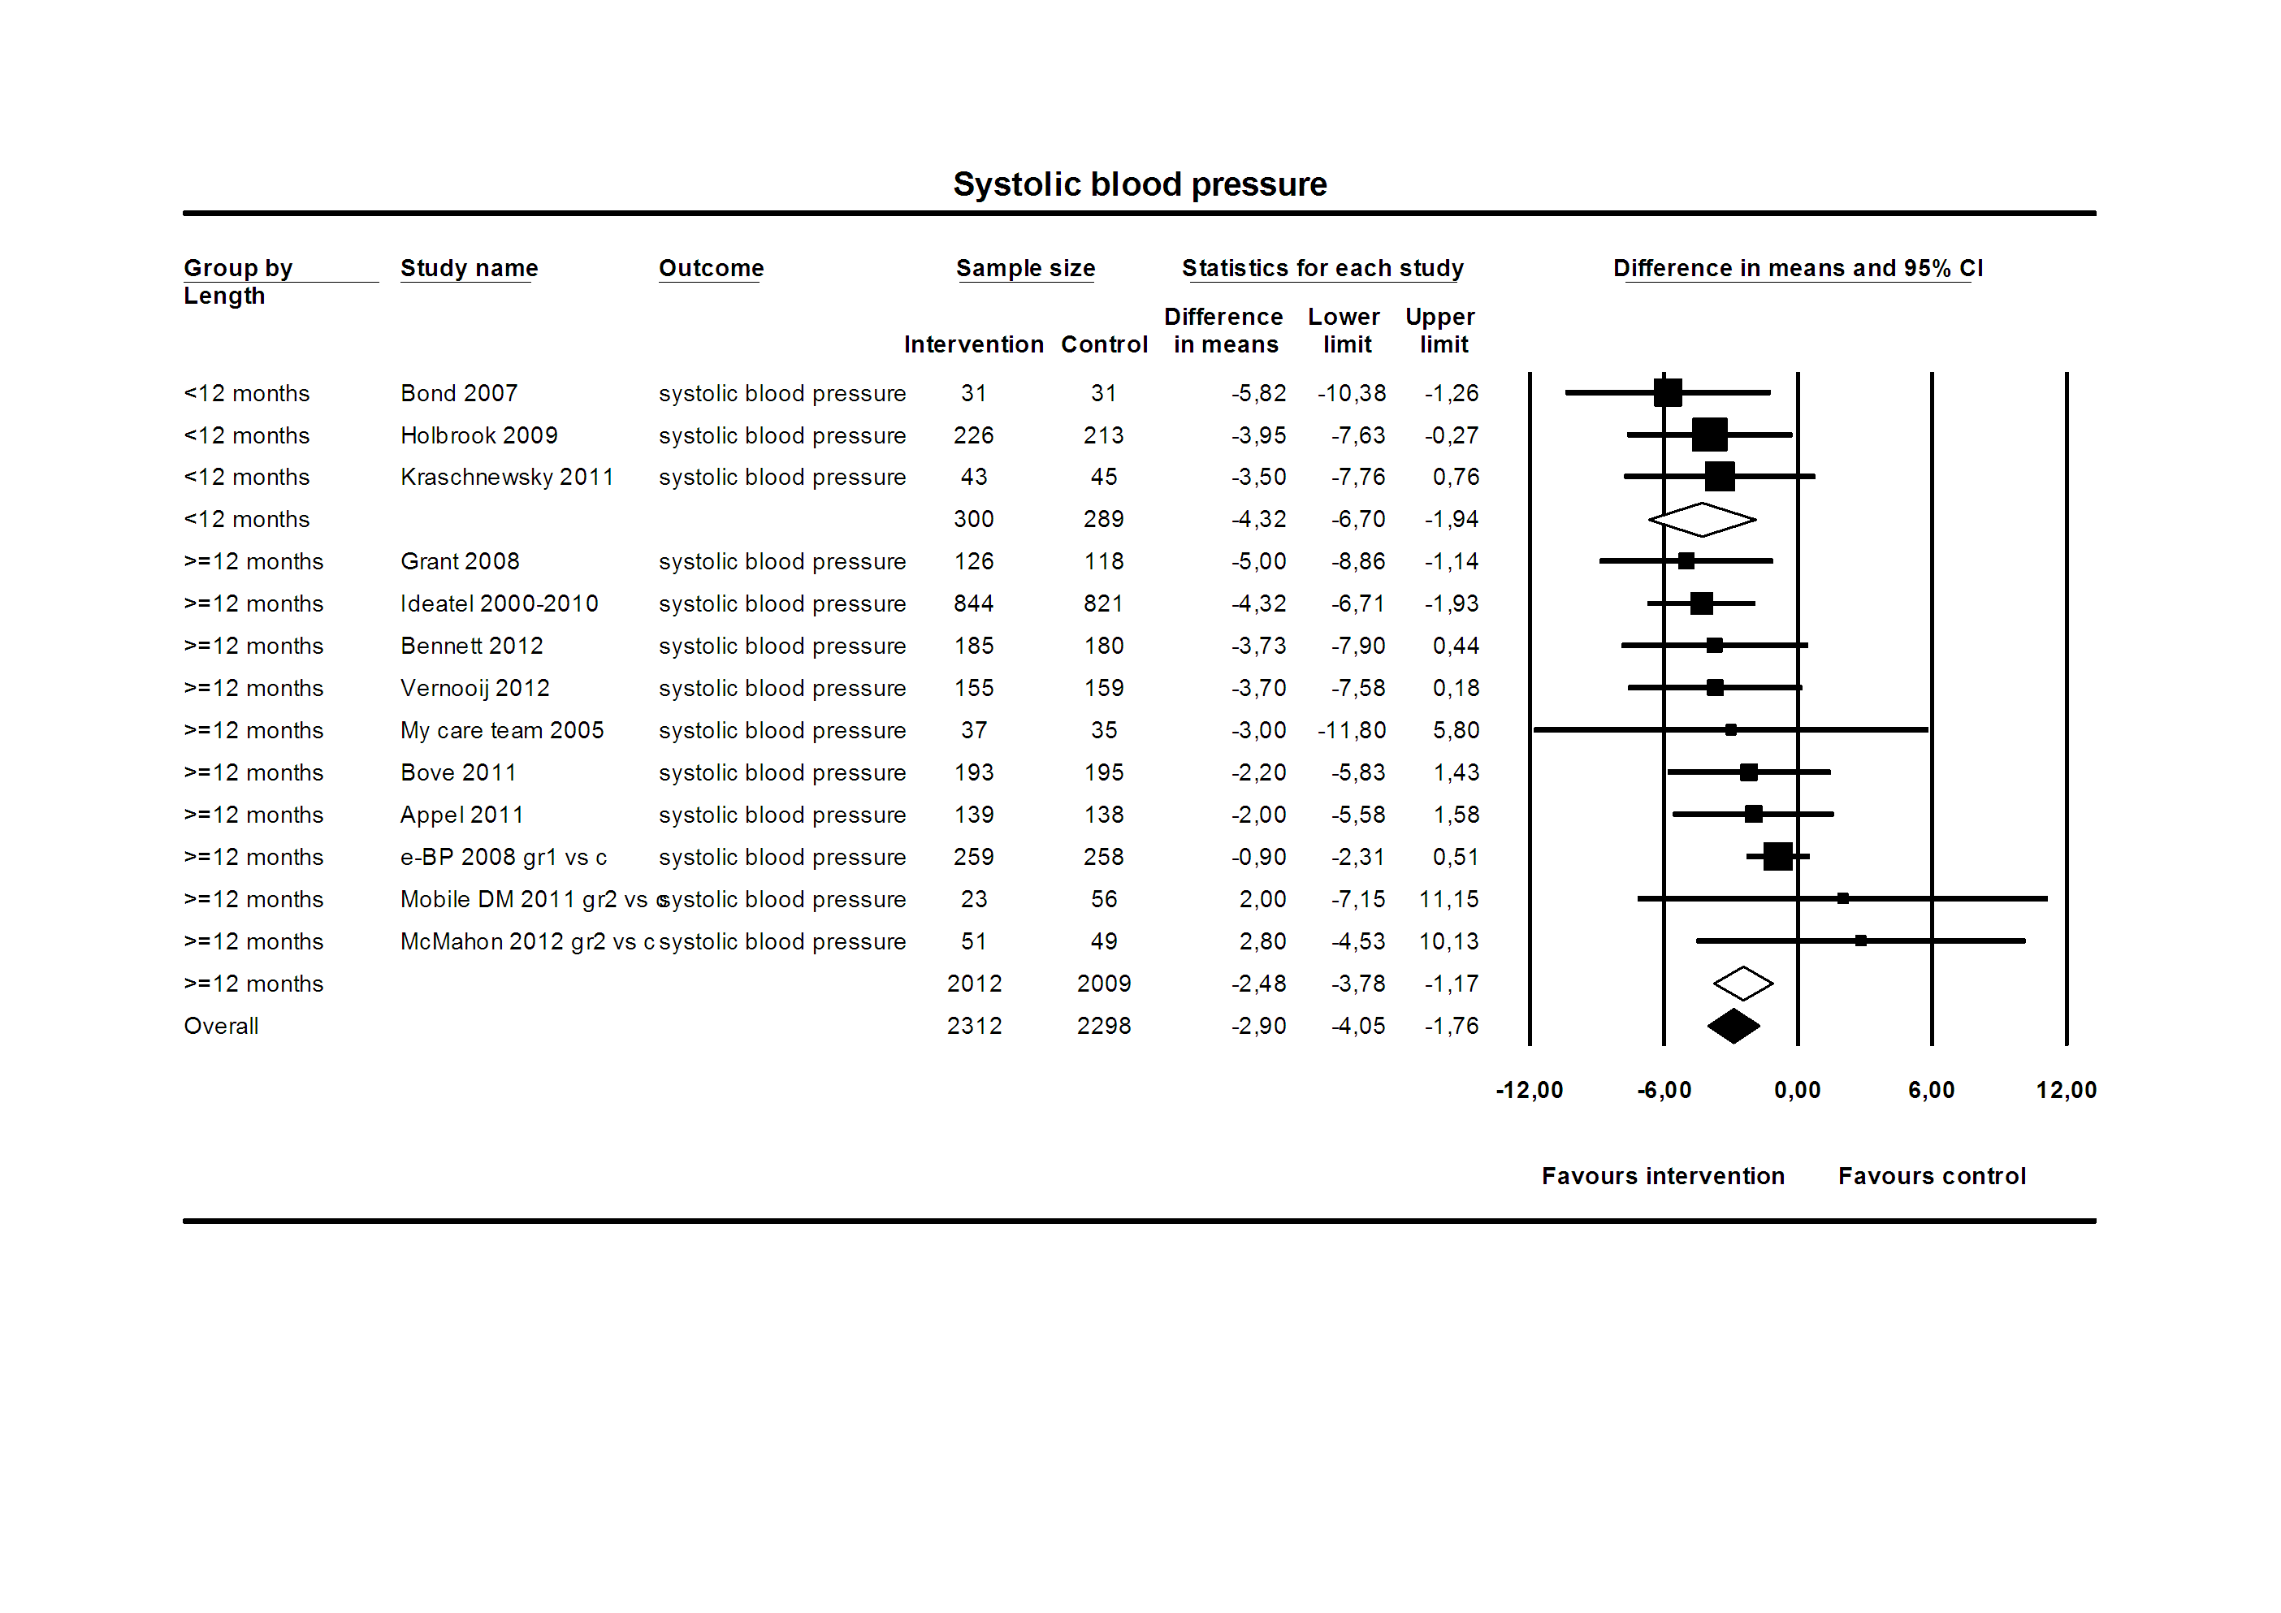
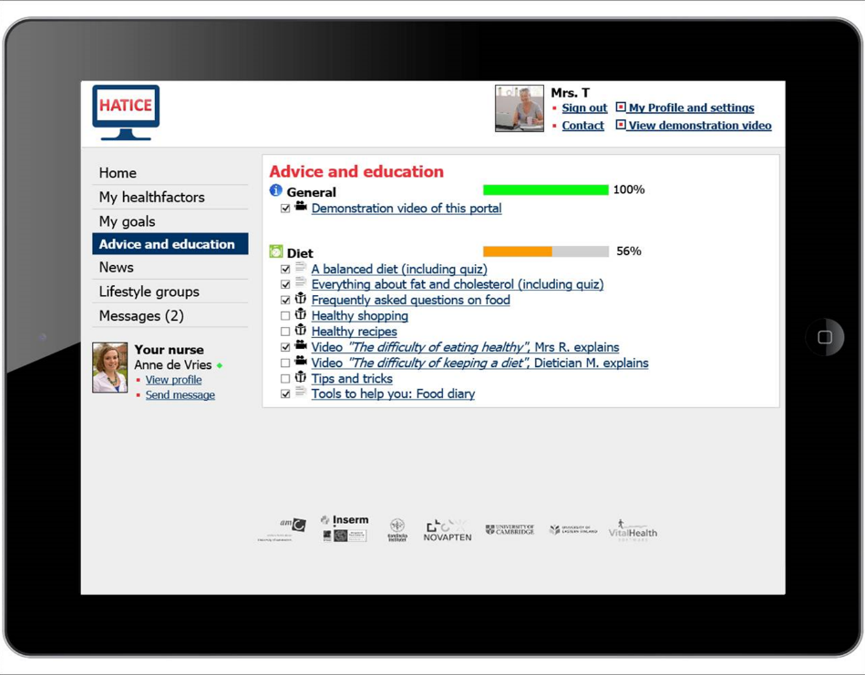

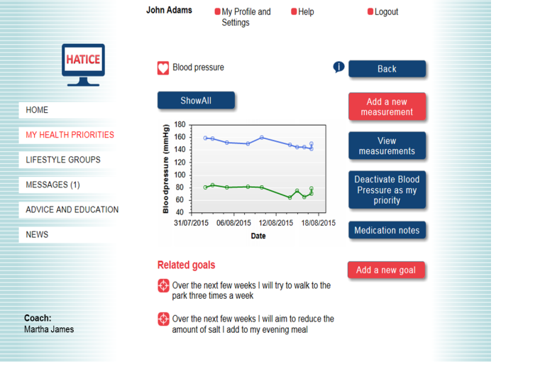

Interactive internet intervention, volunteer studies and now embedded in cohorts
Focus groups:
target population
nurses
doctors
preDIVA
FINGER
MAPT
simple
self-management
goal-setting
personalised
interactive
coach
Notes:
40

Slide 41

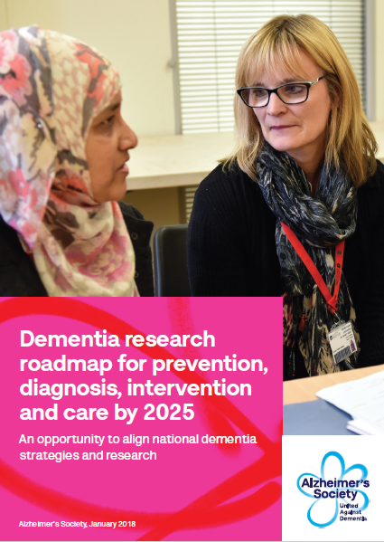
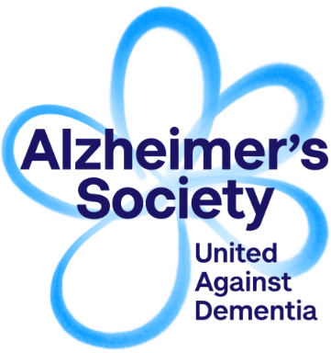
Research investment and a Research roadmap to deliver change for people affected by dementia by 2025
‘What research, in addition to searching for new
treatments, is required to improve the lives of
people affected by dementia today, and reduce
the risk of dementia for future populations?’
Dr James Pickett,
Head of Research, Alzheimer’s Society
@jamespickett12

Slide 42
Dementia and research investment in Australia
A$14.24bn 2016
Investment of A$52.4 in EU’s Joint Programme of Neurodegenerative Disorders (0.36% estimated societal cost)
What was funded: 43% basic, 40% clinical, 17% health and social care
Funders – ARC, NHMRC, Mason Foundation, AADRF
Sources (with thanks to James Pickett Alz Soc UK)
  www.dementia.org.au/files/NATIONAL/documents/The-economic-cost-of-dementia-in-Australia-2016-to-2056.pdf
  www.neurodegenerationresearch.eu/wp-content/uploads/2018/07/JPND-Mapping-Exercise-Report-28Final2912072018.pdf

Slide 43
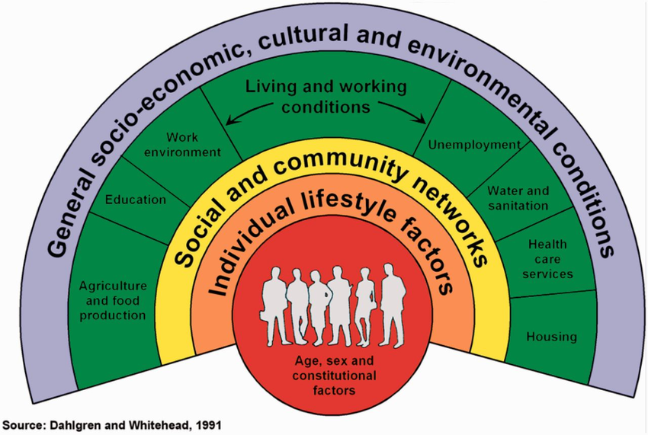
Where now?
Need to use such evidence to inform approaches now and research for the future
Clear evidence that dementia is changing in some global areas
Likely that changes in lifecourse risk have influenced these changes
Primary prevention at population level also addresses inequalities
Secondary and tertiary prevention research investors must examine whether they are gearing for contemporary and future populations

Slide 44

Alzheimer Cohorts Consortium
Rotterdam Study
Daniel Bos
Arfan Ikram
Kamran Ikram
Frank Wolters
Sirwan Darweesh
Framingham Study
Alexa Beiser
Matthew Pase
Sudha Seshadri
Claudia Satizabal
Kendra Davis-Plourde
Imperial College London
Alison Ower
Mei Mei Wong
Stephanie Evans
Sir Roy Anderson
Chris Hadjichrysanthou
CHS
Josh Bis
Lew Kuller
Bruce Psaty
Oscar Lopez
3-Cities Study
Carole Dufouil
Catherine Helmer
Stephanie Debette
Christophe Tzourio
ARIC study
Eric Boerwinkle
Thomas Mosley
Myriam Fornage
Harvard Chan School
Jaap Goudsmit
Albert Hofman
Reem Waziry
CFAS
Carol Brayne
Bloss Stephan
Fiona Matthews
Gothenburg Study
Erik Joas
Silke Kern
Valter Sundh
Ingmar Skoog
Anna Zettergren
Janssen Prevention Center
Gerrit Jan Weverling
Frank de Wolf
PAQUID
Leslie Grasset
Jean-Francois Dartigues
AGES study
Lenore Launer
Osorio Meirelles
Vilmundur Guðnason
Funded by unrestricted grant from Janssen Prevention Center

Slide 45













CFAS Institutions and collaborations (lead collaborators)

