Slide 1

Disinhibited Behaviours:
Negative Mindset to Positive Response
A/Prof Cindy Jones
Faculty of Health Sciences & Medicine, Bond University
Menzies Health Institute Queensland

Slide 2

Negative Mindset?
Disinhibited Behaviours
Enormous Stress (distress, embarrassment, annoyance & frustration)

Slide 3
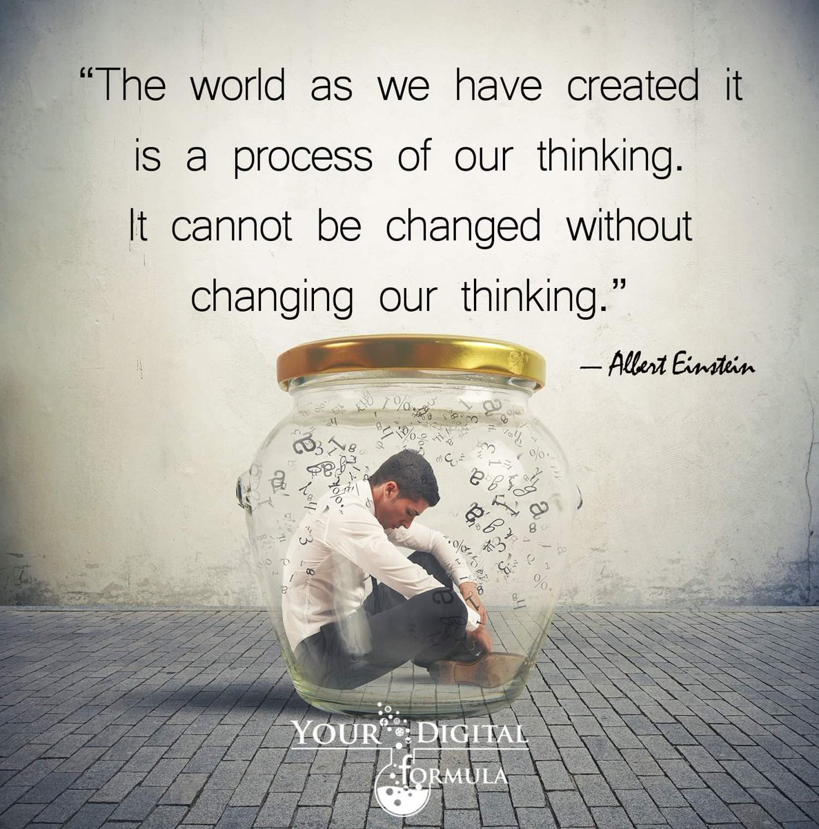
Thinking-Feeling Connection
Does disinhibited behaviour directly lead to emotional response?
  “Despite all my care for him, my dad just lashes out and curse at me often and this made me so angry”
Is there a missing link?
  Thoughts & Beliefs

Slide 4
Our thoughts influence our feelings…
Thoughts
(automatic)
Feelings
Reaction
Response

Slide 5

Scenario: You are a carer for your Dad who has dementia and is living with you. A female friend of yours came over for a visit and you just finished having a cuppa and a yarn with her at the veranda. As she is leaving and you are walking her to the front door, both of you saw your Dad talking all his clothes off in the lounge room.
Negative Thought ☹ | “Oh dear, I can’t believe she just saw that. She must think my Dad is weird, an exhibitionist or a sexual deviant! For goodness' sake, I just wish Dad will stop doing that”
Feeling(s) | Embarrassed and annoyed.
Reaction/Response | Inappropriate sexual behaviour that needs to be stopped.

Slide 6
Scenario: You are a carer for your Dad who has dementia and is living with you. A female friend of yours came over for a visit and you just finished having a cuppa and a yarn with her at the veranda. As she is leaving and you are walking her to the front door, both of you saw your Dad talking all his clothes off in the lounge room.
Positive Thought ☺ | “Hmm, she looks taken back. Is Dad feeling hot or uncomfortable in those clothes? Are they too tight on him or is the material of the clothing irritating him!”
Feeling(s) | Calm but concerned albeit some embarrassment.
Reaction/Response | Checking out if Dad is feeling hot or if there is an issue with the clothing.

Slide 7

Changing mindset:
Could disinhibited behaviours reflect an unmet need?

Slide 8

Unmet Needs Model
Decreased ability to meet one’s needs because of an increasing difficulty in communicating these needs, and a decreased ability to provide for oneself…
May or may not be apparent to caregivers…
Cohen-Mansfield J, Dakheel-Ali M, Marx MS, Thein K, Regier NG. Which unmet needs contribute to behavior problems in persons with advanced dementia?. Psychiatry Res. 2015;228(1):59-64. doi:10.1016/j.psychres.2015.03.043

Slide 9
Lifelong habits & personality
Behaviours as a means of fulfilling needs
Current condition (physical & mental)
Behaviours as a means of communicating needs
Unmet Needs
Environment
(physical & psychosocial)
Behaviours as an outcome frustration & other negative affects interacting with decreased inhibition
Unmet Needs Model
(c) Cohen-Mansfield J, Dakheel-Ali M, Marx MS. Engagement in persons with dementia: the concept and its measurement. Am J Geriatr Psychiatry. 2009 Apr;17(4):299-307. doi: 10.1097/JGP.0b013e31818f3a52. PMID: 19307858; PMCID: PMC2684326.

Slide 10
Negative Mindset to Positive Response
Changing thoughts and beliefs (mindset)
Reduce negative feelings
Leading to positive reaction/response
Improved outcome for people living with dementia & caregivers

Slide 11


