Slide 1
Nana you can’t say that
Kate Hawkins
Project Manager: Specialist Dementia Care Program

Slide 2
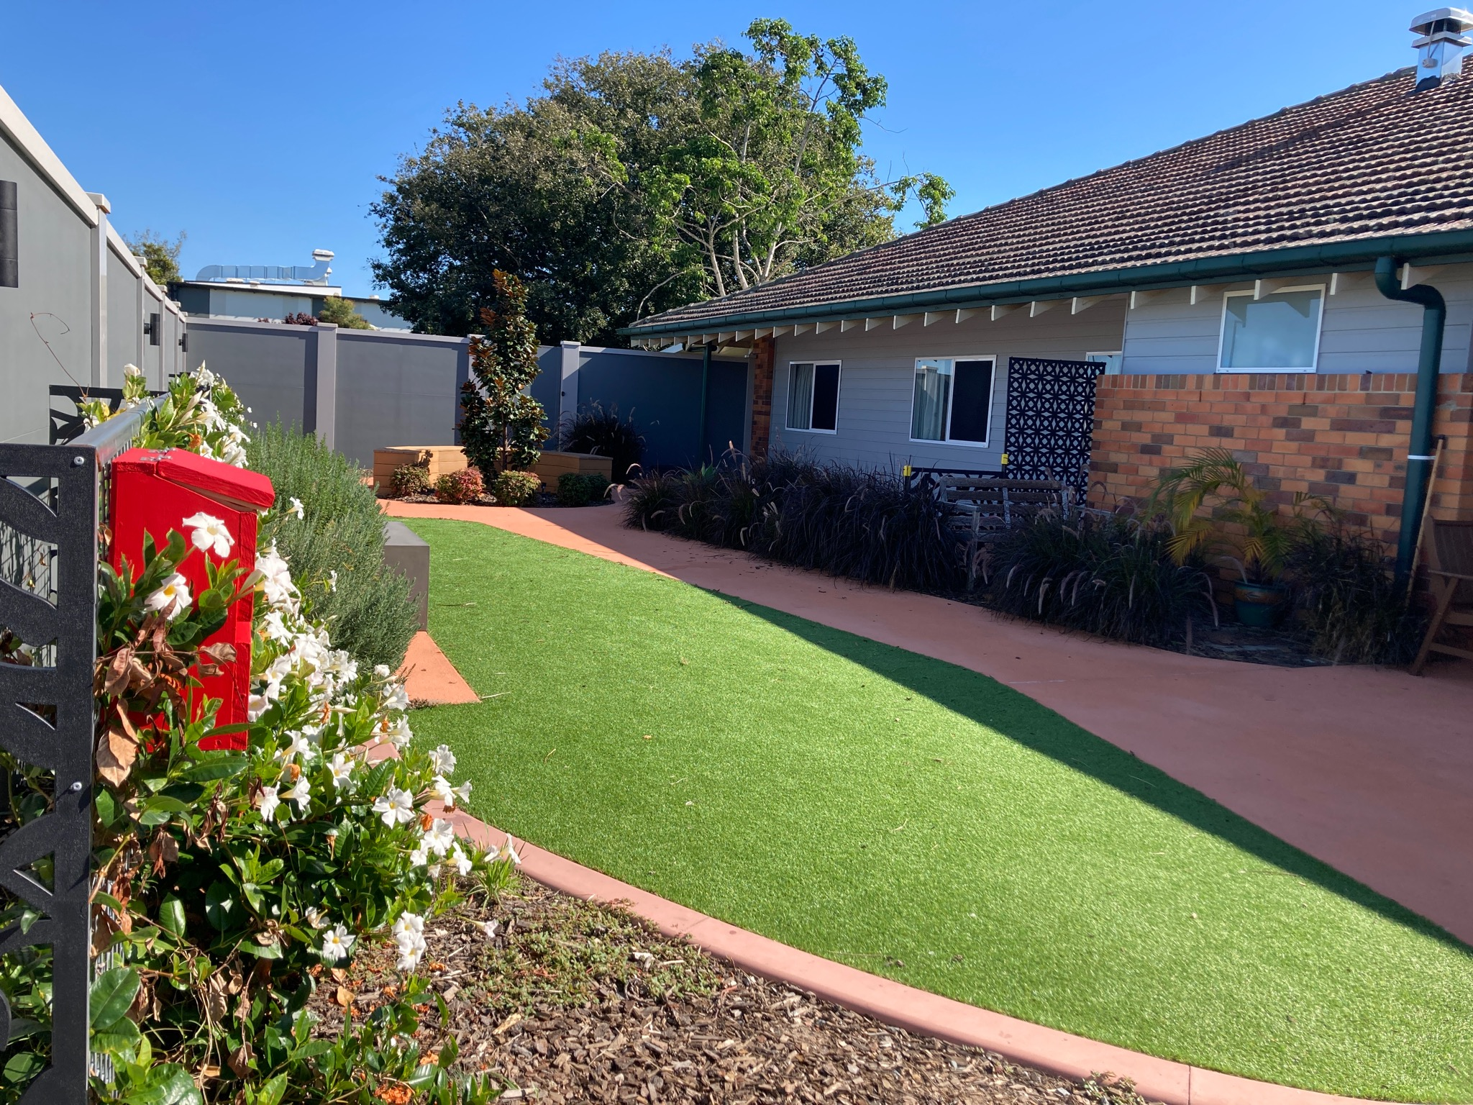
Specialist Dementia Care Program Unit (SDCP)
The units provide specialised care to people with very severe behavioural and psychological symptoms of dementia.
They aim to reduce or stabilise symptoms so that people can move into less intensive care settings.
https://www.health.gov.au/initiatives-and-programs/specialist-dementia-care-program-sdcp
Before you refer someone to a unit, find out about the entry requirements on the Dementia Support Australia website.

Slide 3
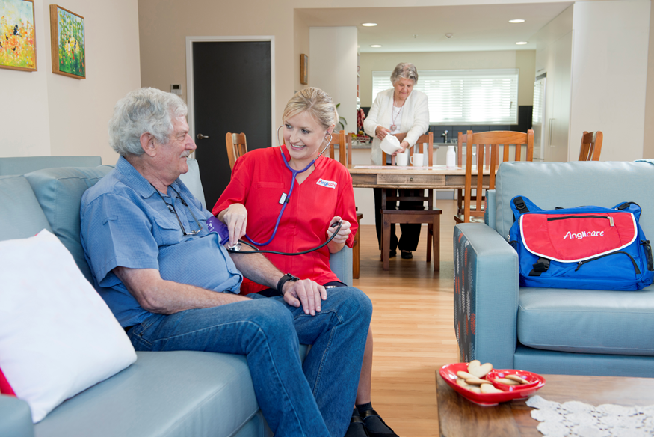
Case Study: Mr D
BACKGROUND
77-year-old gentlemen
Dx with Alzheimer's Disease in 2017
Admitted into Residential Aged Care in 2019 due to no longer being able to live at home safely
Once admitted into aged care Mr D displayed;
- Physical aggression during hygiene cares
- Verbal Agitation
- Sexual disinhibition
The aged care facility found Mr D’s sexual disinhibition most challenging due to the affect on other female residents and staff
Due to this Mr D was admitted to the Cognitive Assessment and Management Unit (CAMU) at Prince Charles Hospital
Referred to the SDCP from DSA

Slide 4
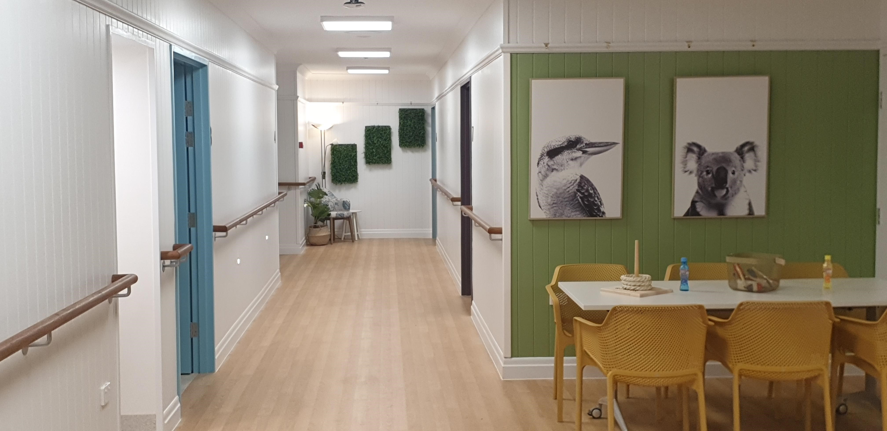
On Admission to the SDCP Unit
Mr D’s main presentation were:
Gets excited especially when staff come near him and during showers
Tends to masturbate when female staff attending to hygienic cares
Can get excited when he sees scenes on the television
Disrobes in general areas
Increase in agitation when staff intervened to ‘stop’ him

Slide 5
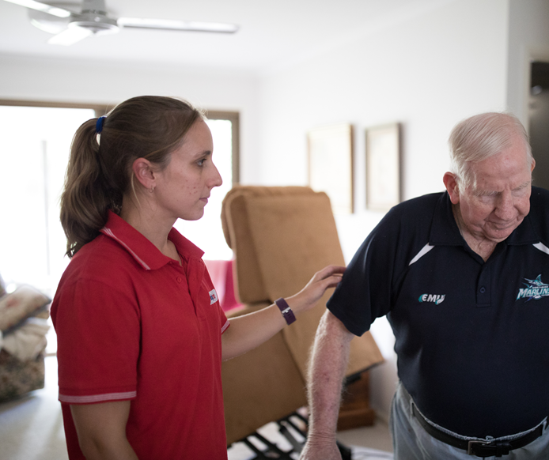
How staff approved Mr D’s Disinhibition
Hygienic Cares
  Staff had every equipment ready prior to do the cares so that they can do this quickly
  Staff encouraged and taught Mr D to do his private area cares.
When he got excited in the shower, staff quick finishing the shower and cover him with a towel and leave him on a chair for 10 minutes and close the bathroom door and give him privacy. Attend after 10-15 minutes
In General Areas
When Mr D gets excited and approach staff, staff redirected him with a smile/calm manner to his room and let him lie on his bed, covered with blanket and closed his room to facilitate privacy
Staff used to screen what they put on as a movie or T.V programs in common areas. However, he was not limited in his room.
Redirection to his room, close the door and provide privacy
Other Interventions
Geriatrician reviews
Case Conferencing with staff and family

Slide 6
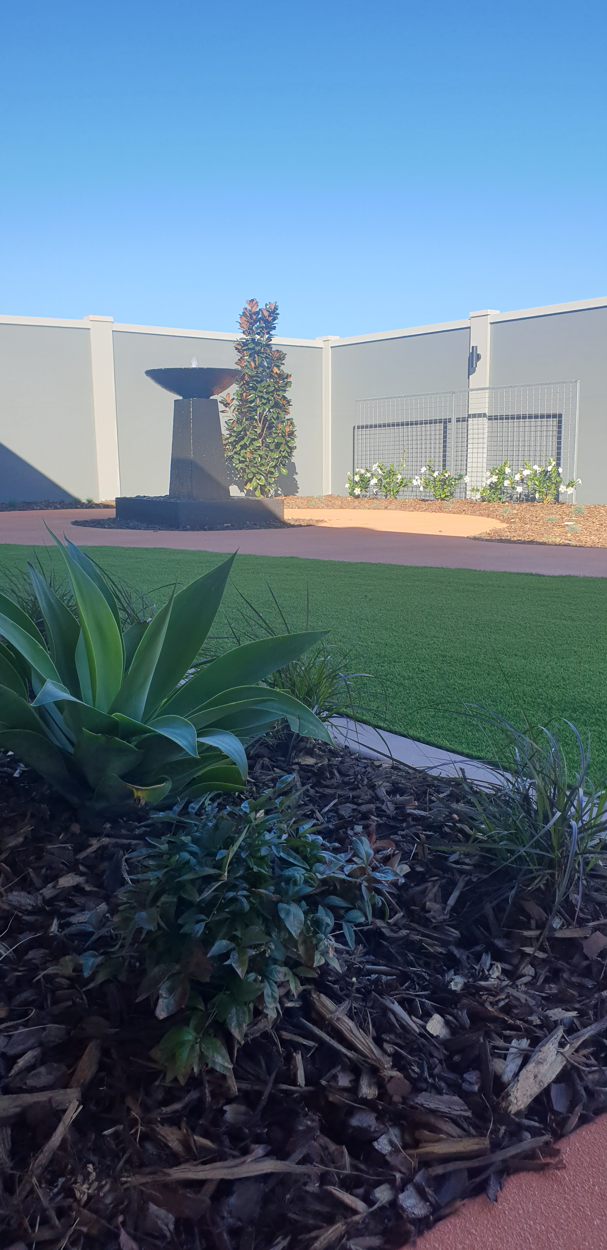
Outcomes of Staff Interventions
Decrease in physical and verbal aggression
Decreased episodes of sexual disinhibition in general areas and advances to staff
Family noticed a remarkable change in Mr D wellbeing as rather then his behaviour being labelled ‘inappropriate’, Mr D was able to explore his sexuality in a safe environment
Due to the successful care interventions Mr D was able to be transferred out into a mainstream dementia support unit

Slide 7
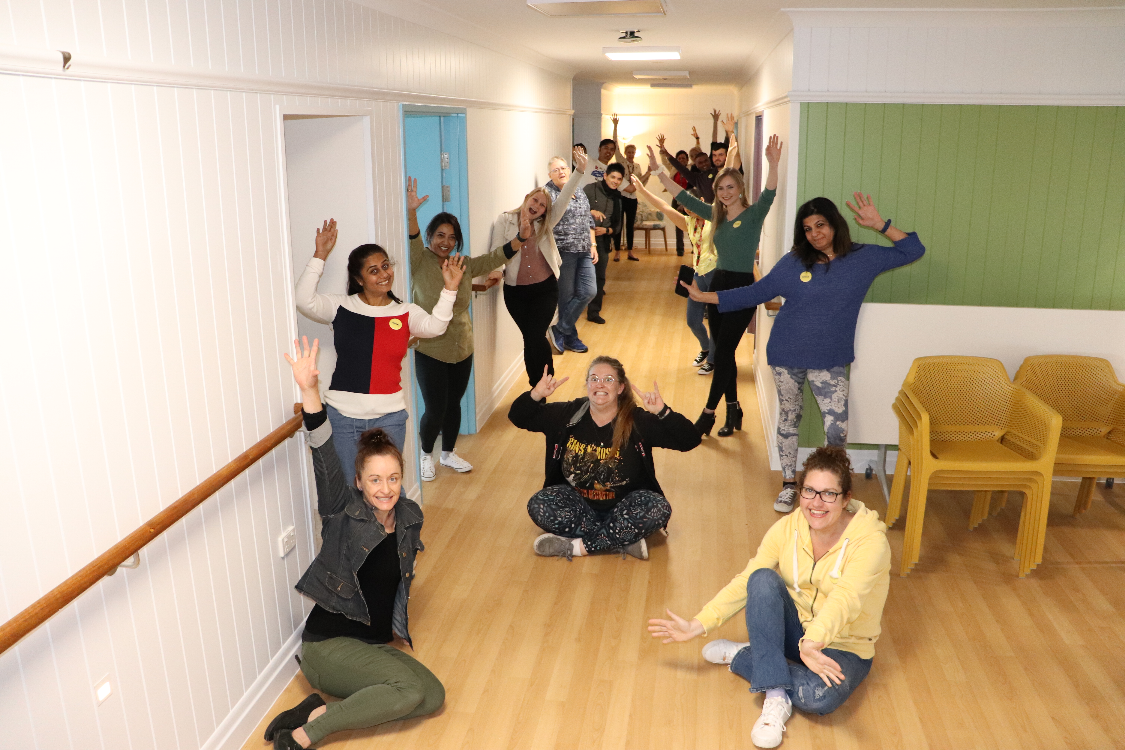
The Key to Success
Seeing from a different perspective made all the trick
Not observing the behaviour as a ‘problem’ rather then how can we facilitate with dignity and respect for Mr D and other residents in the unit
Lots of education and one on one communication with the staff conducted
Support for the family

